Slide 1
TOPOISOMERASES
Fernando Camacho Navarro
Seher Kosar

Slide 2
OUTLINE
INTRODUCTION
FUNCTION OF TOPOISOMERASES
SUBFAMILIES TYPES.
THE CONCLUSIONS
REFERENCES
PEM

Slide 3
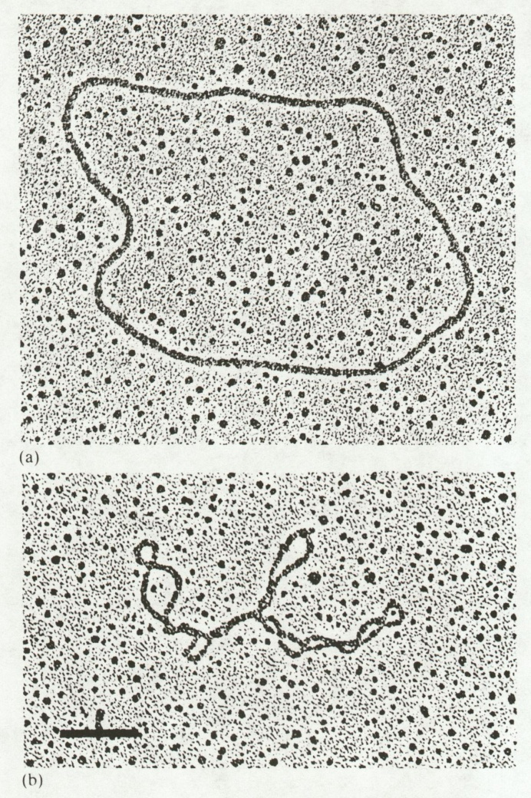
INTRODUCTION
From http://genome.cbs.dtu.dk/staff/dave/roanoke/genetics980213a.html

Slide 4
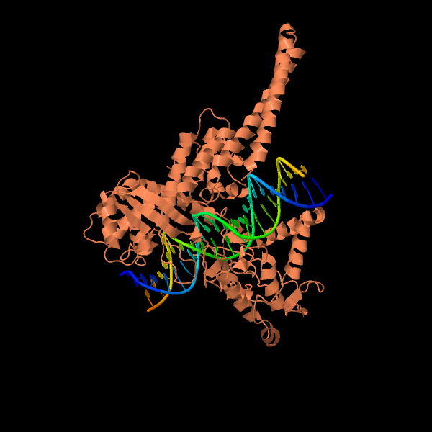
INTRODUCTION

Slide 5
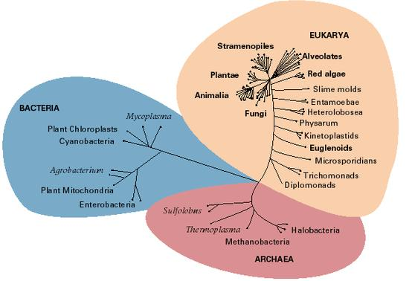
INTRODUCTION
From http://genome.cbs.dtu.dk/staff/dave/roanoke/genetics980213a.html

Slide 6
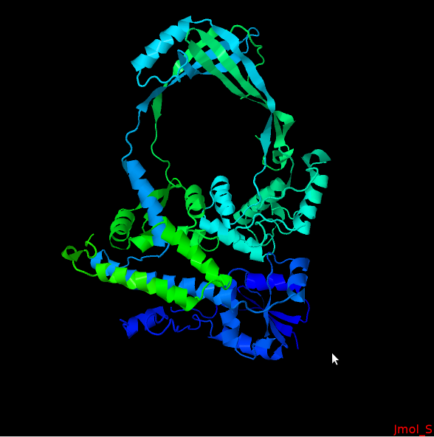
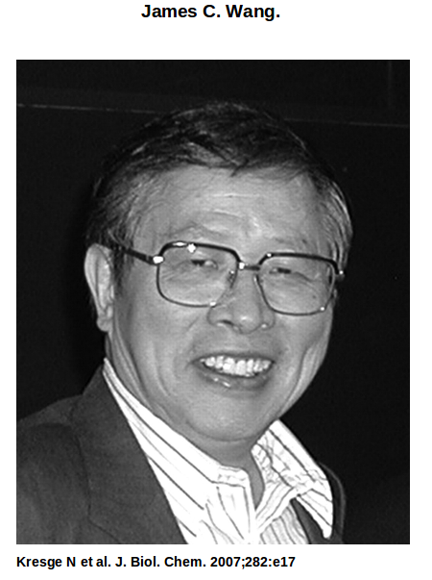
INTRODUCTION
Discovery of DNA topoisomerease: E.coli topoisomerease I

Slide 7
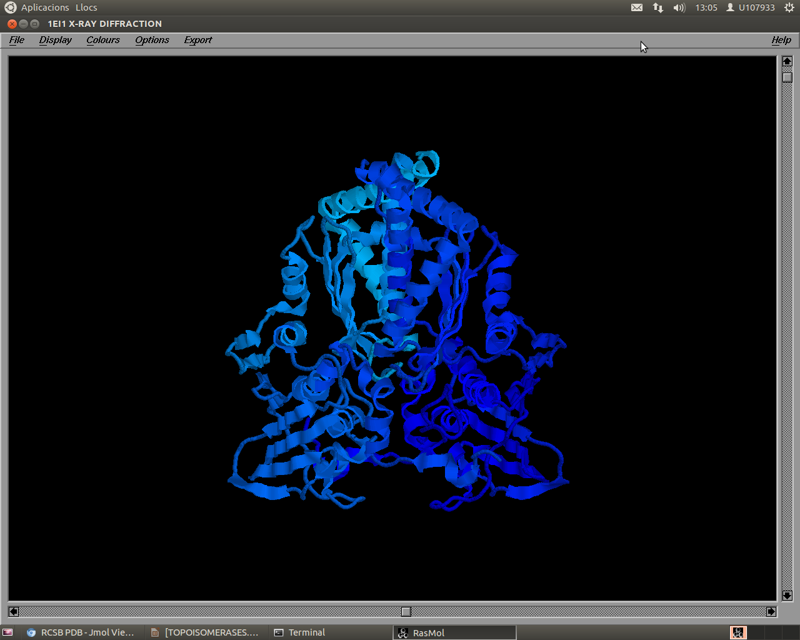
INTRODUCTION
Second discovered topoisomerease :DNA Gyrase (1976)

Slide 8
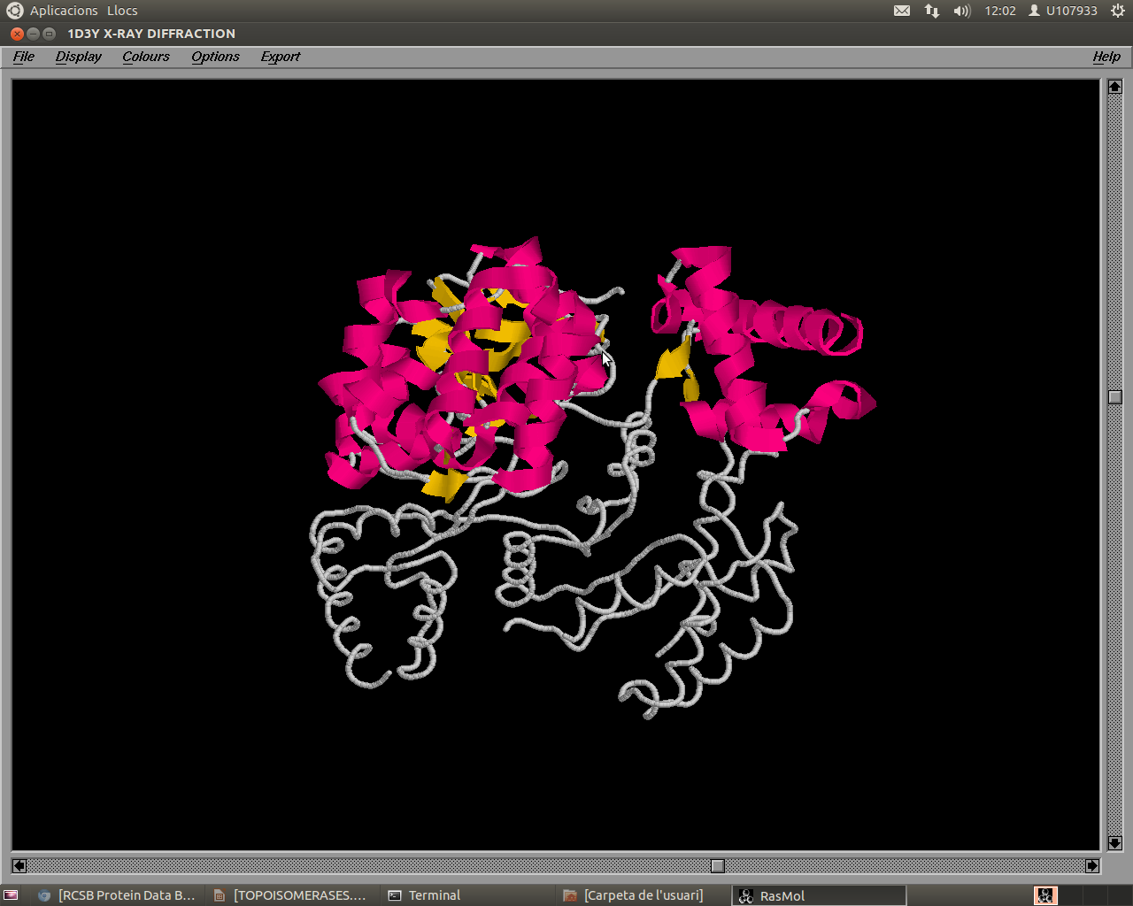
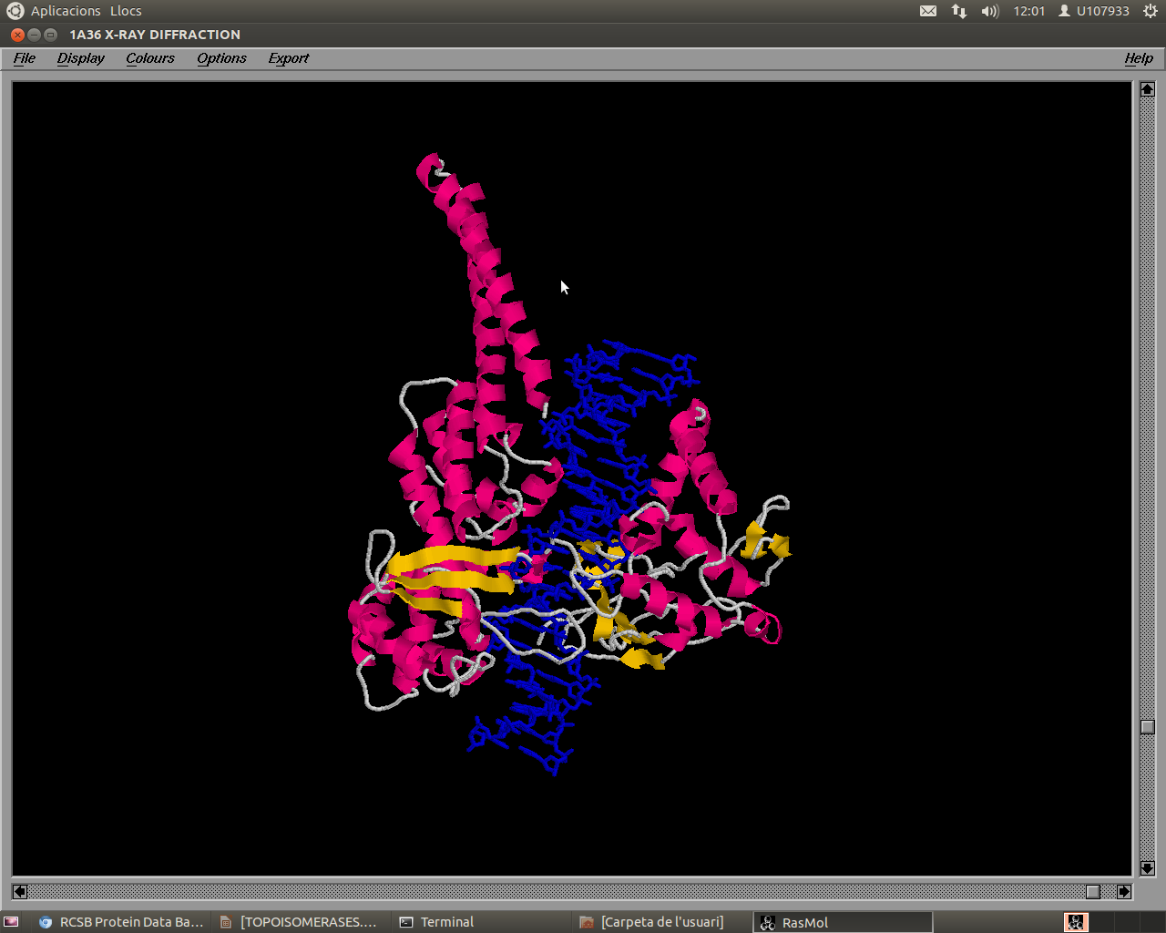
INTRODUCTION
Examples of topoisomereases

Slide 9
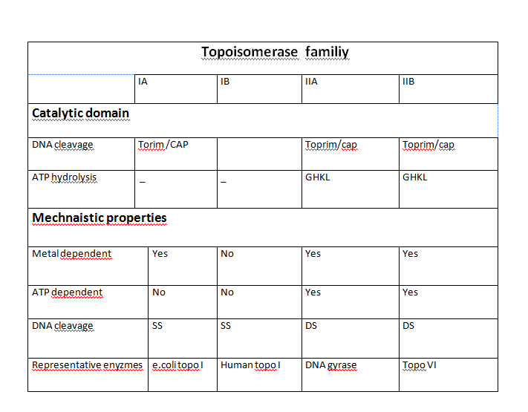
INTRODUCTION
Corbett K.D. and James M. Berger J.M

Slide 10
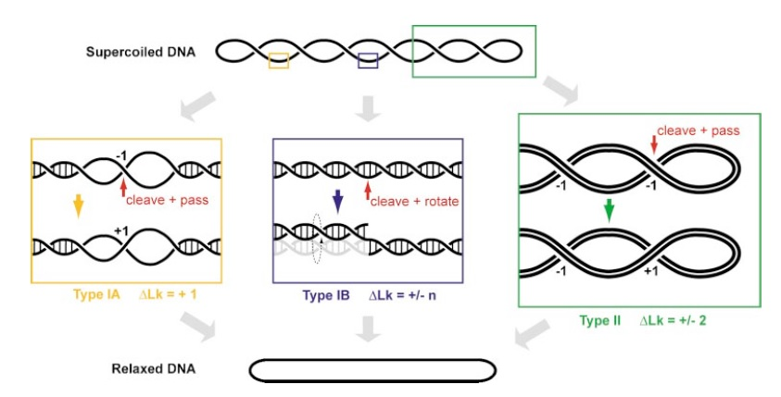
FUNCTION OF TOPOISOMERASES
General aspects about mechanisms
Corbett K.D. and James M. Berger J.M
Corbett K.D. and James M. Berger J.M

Slide 11
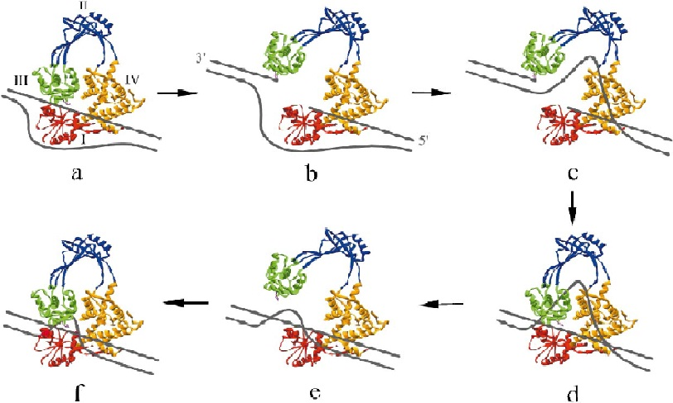
FUNCTION OF TOPOISOMERASES
Mechanism of topoisomerease IA
CLASS I TOPOISOMERASE MECHANISM
Champoux, J. J

Slide 12
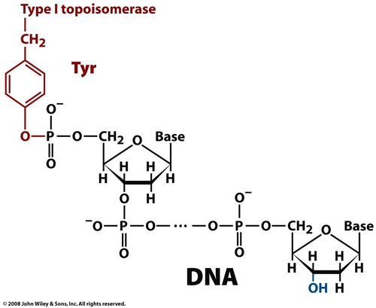
FUNCTION OF TOPOISOMEREASES

Slide 13
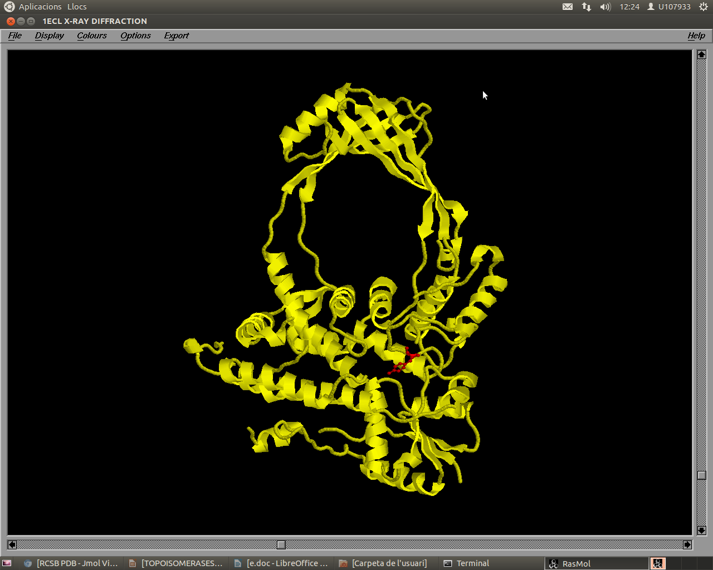
FUNCTION OF TOPOISOMEREASES
TYR-319

Slide 14
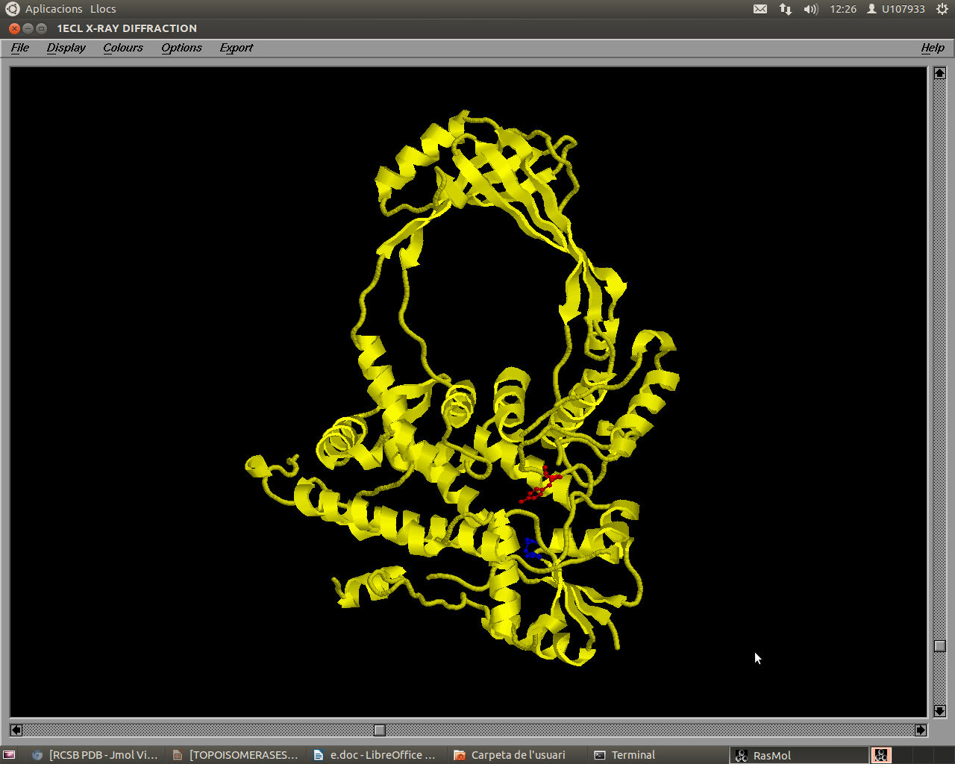
FUNCTION OF TOPOISOMEREASES
TYR-319 AND GLU-9

Slide 15
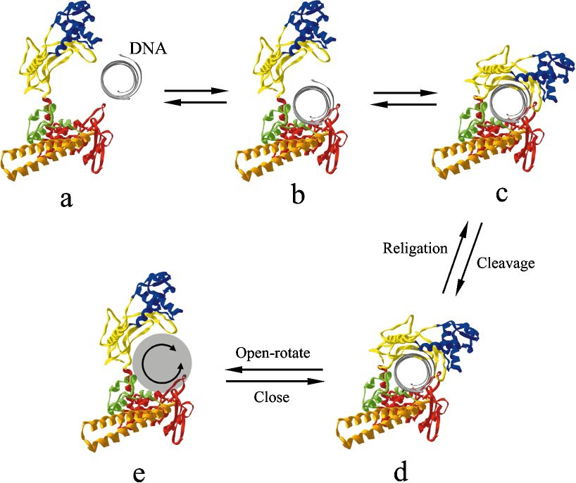
FUNCTION OF TOPOISOMEREASES
Mechanism of topoisomerease IB
Champoux, J. J

Slide 16
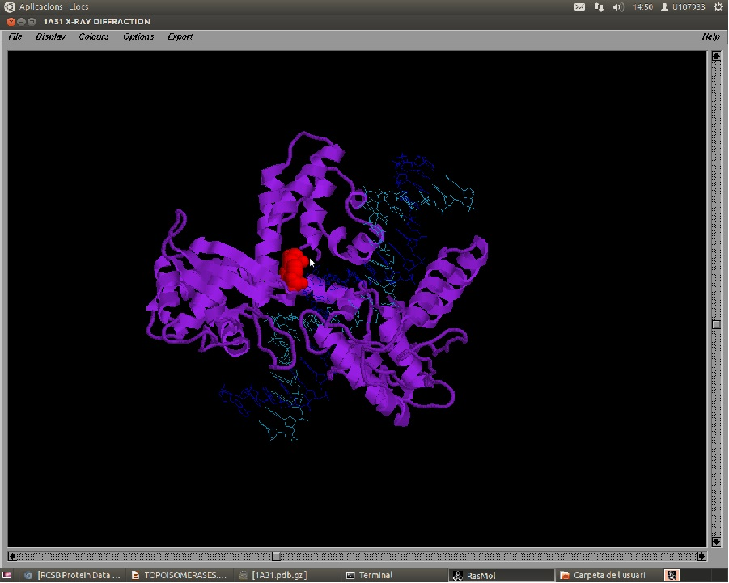
FUNCTION OF TOPOISOMEREASES
Human topoisomerase I: TYR-723

Slide 17
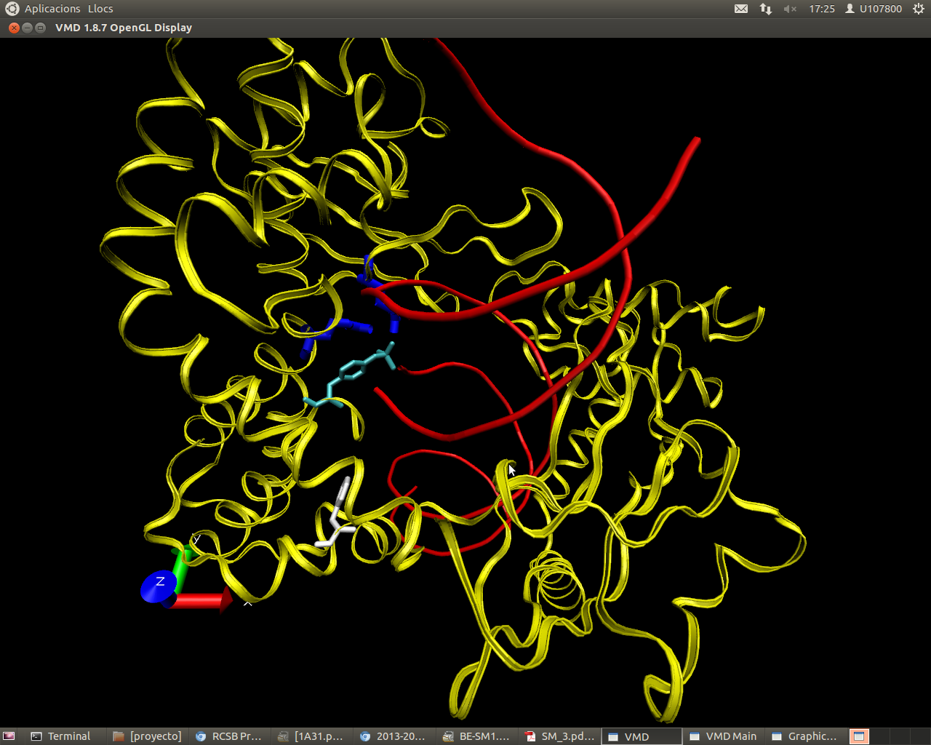
FUNCTION OF TOPOISOMERASES
Nucleophilic attack of human topoisomerase I

Slide 18
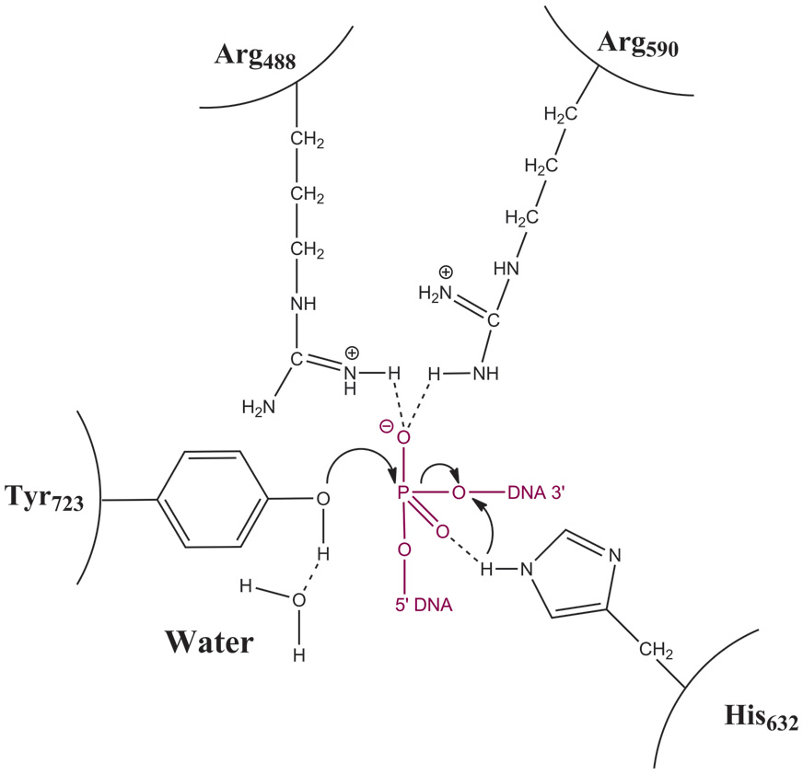
FUNCTION OF TOPOISOMEREASES
Nucleophilic attack of human topoisomerase I
From http://structuralbiology.bio.uniroma2.it/node/129

Slide 19
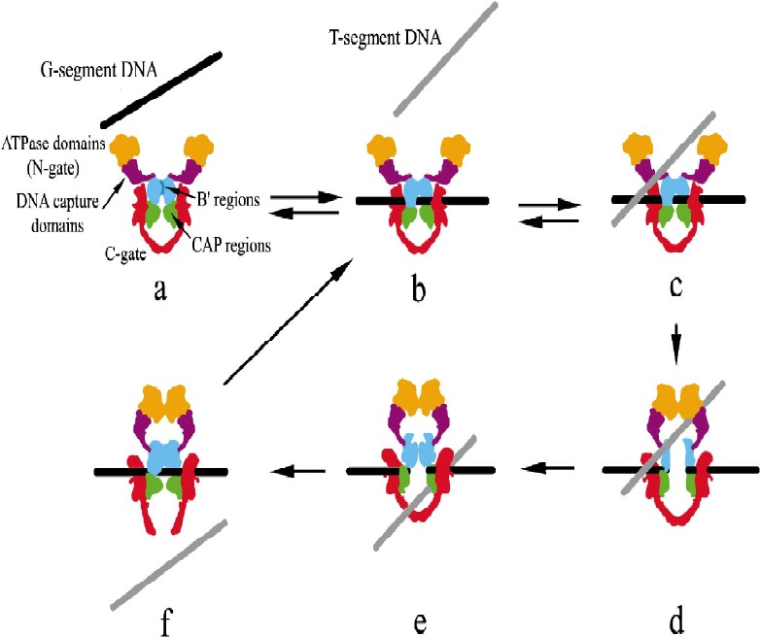
FUNCTION OF TOPOISOMERASES
Mechanism of topoisomerease II
CLASS II TOPOISOMERASE MECHANISM- FUNTION
Champoux, J. J

Slide 20
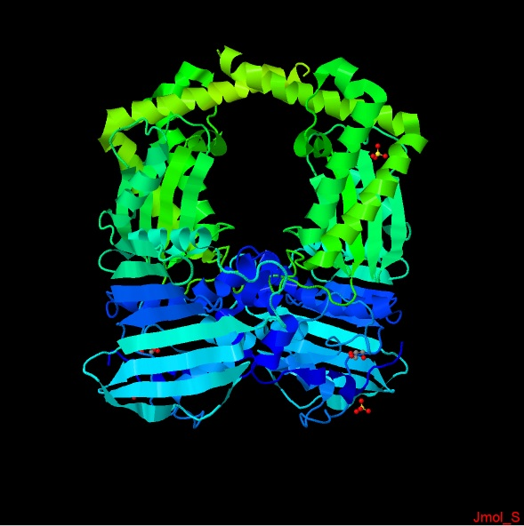
FUNCTION OF TOPOISOMERASES
DNA GYRASE

Slide 21
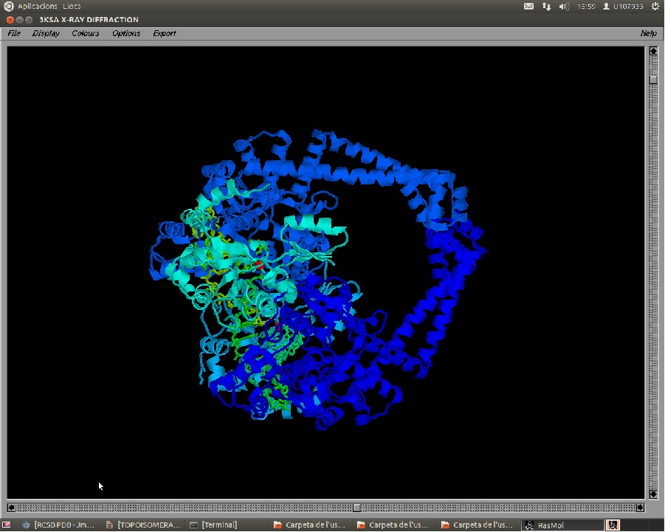
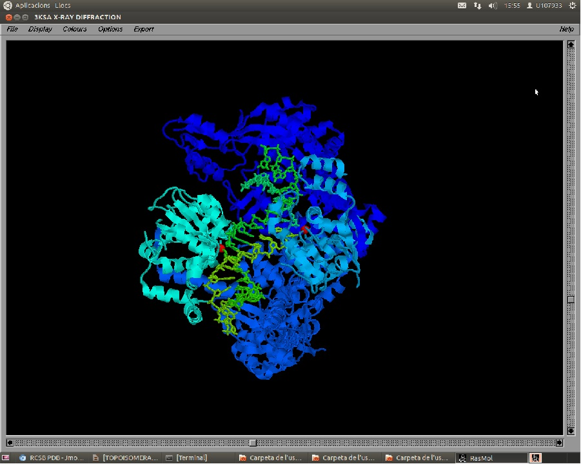
FUNCTION OF TOPOISOMEREASES

Slide 22
Subfamilies types.

Slide 23
Type IA DNA Topoisomerase General features.
They are all monomeric, except for Reverse Gyrase.
Cleavage of a DNA strand is done by a 5’ covalent phosphodiester bond with the active tyrosine.
All require Mg(II) for DNA relaxation activity.
Plasmids containing negative supercoils are substrates for the relaxation reaction.
The relaxation of negative supercoils does not go to completion.
All enzymes in this subfamily require an exposed single-stranded region within the substrate DNA.
Relaxation of DNA changes the linking number in steps of one.
These enzymes can catalyze the knotting, unknotting, and interlinking of single-stranded circles as well as the knotting, unknotting, catenation, and de- catenation of gapped or nicked duplex DNA circles.

Slide 24
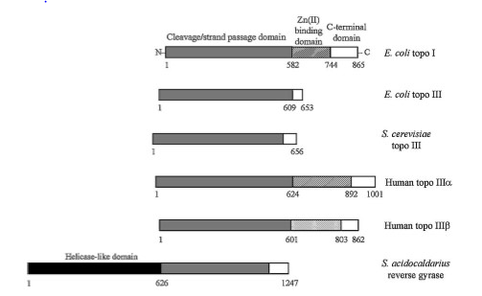
Type IA DNA Topoisomerase.

Slide 25
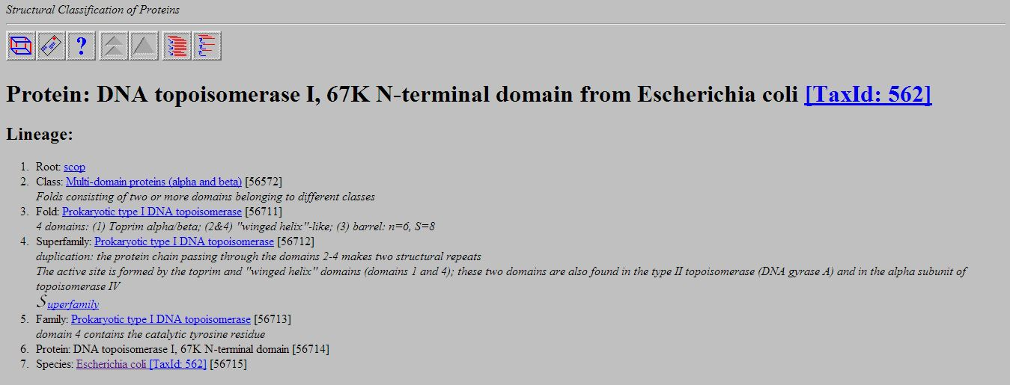
E. Coli DNA Topoisomerase I Structure.

Slide 26
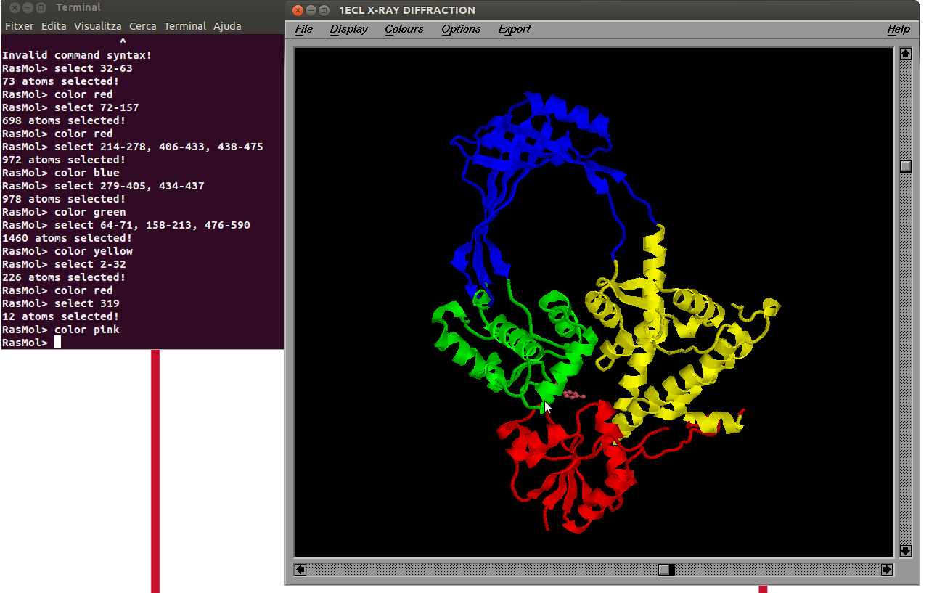
E. Coli DNA Topoisomerase I Structure.

Slide 27
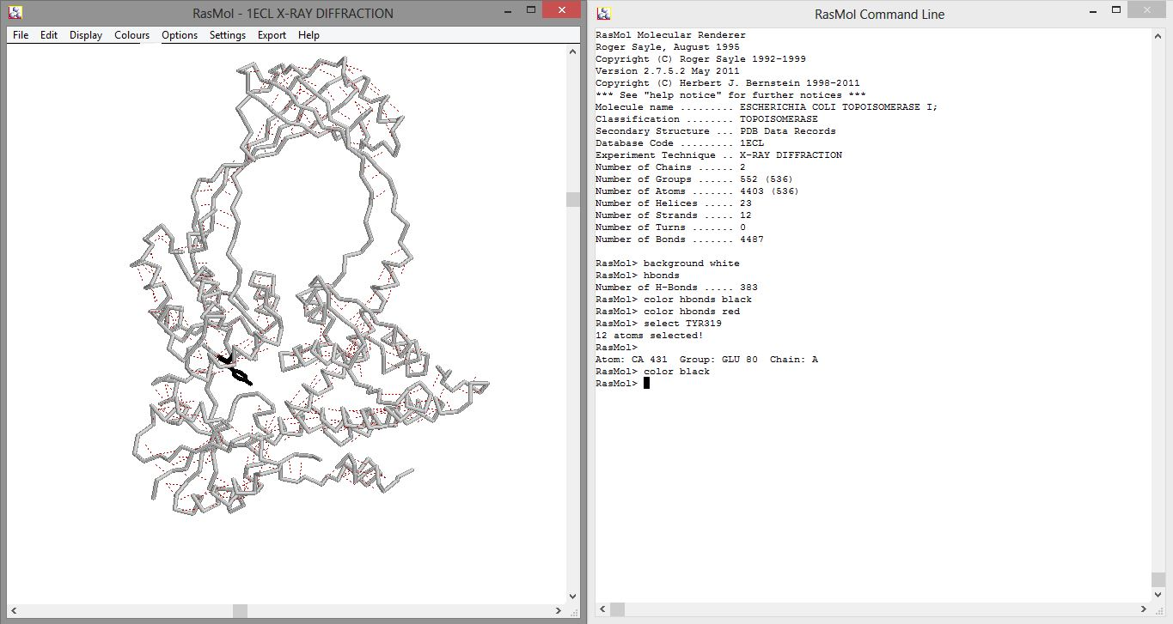
E. Coli DNA Topoisomerase I Structure.

Slide 28
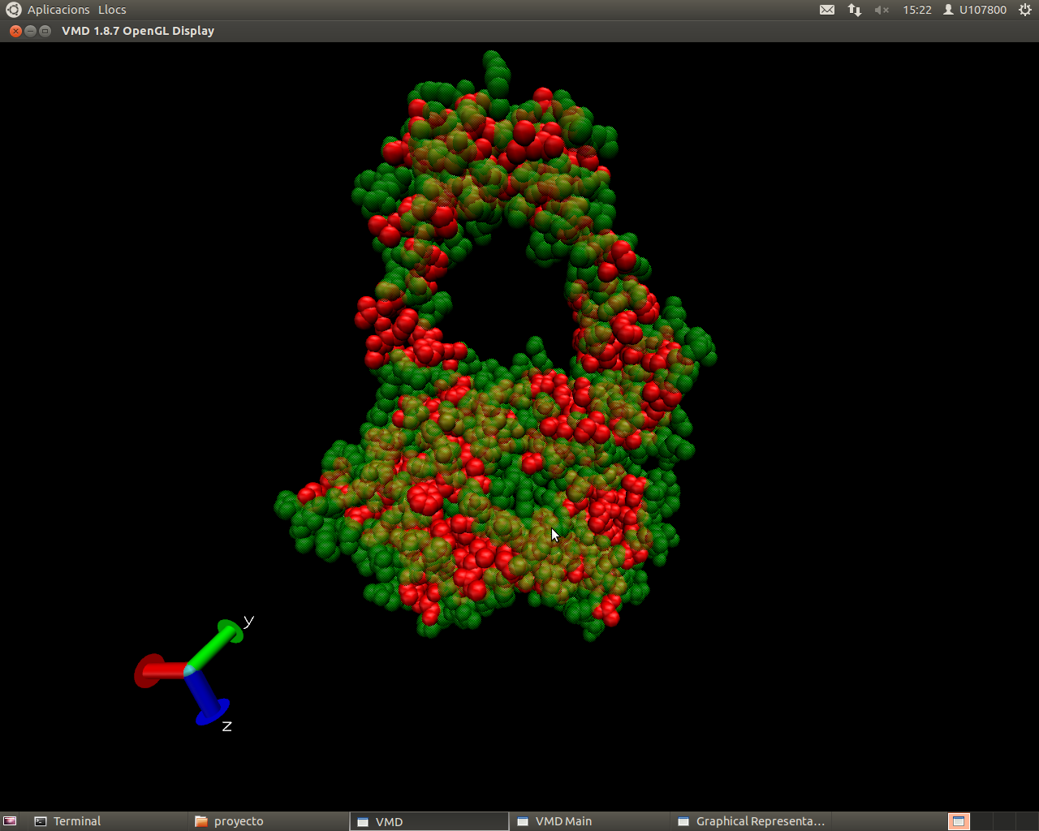
E. Coli DNA Topoisomerase I Structure.

Slide 29
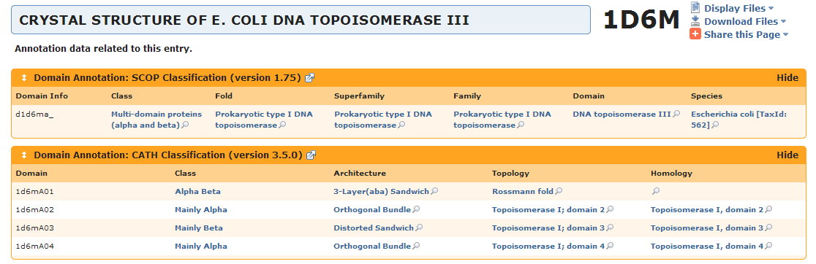
E. Coli DNA Topoisomerase III Structure.

Slide 30
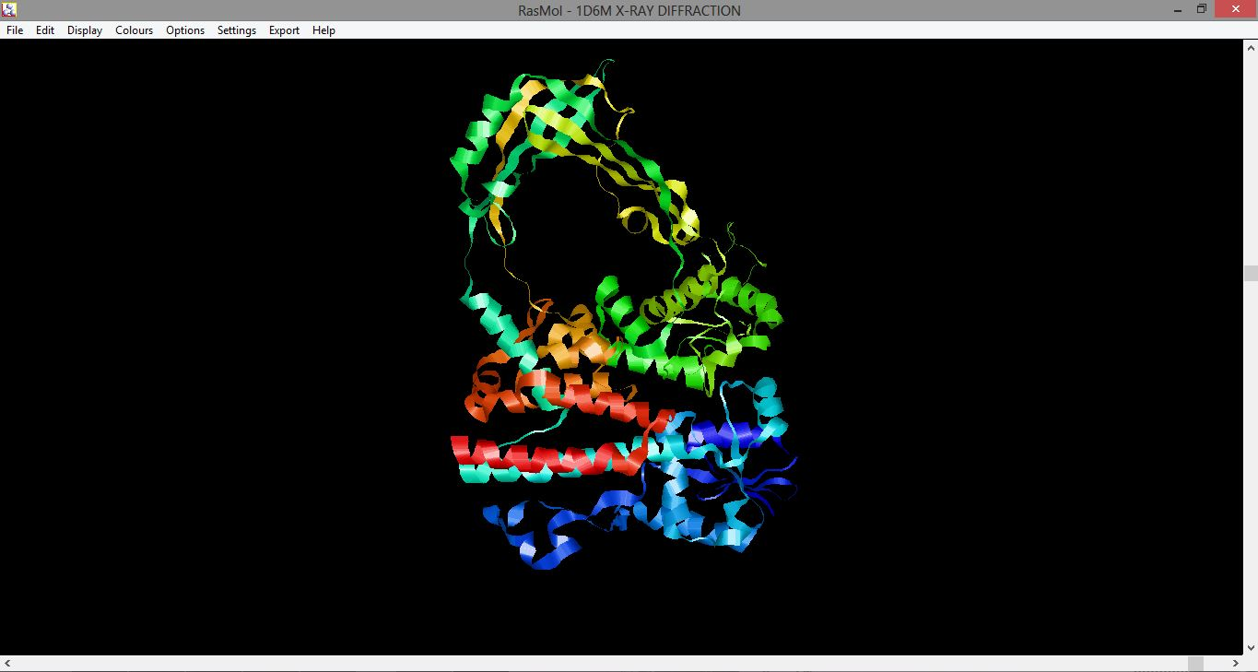
E. Coli DNA Topoisomerase III Structure.

Slide 31
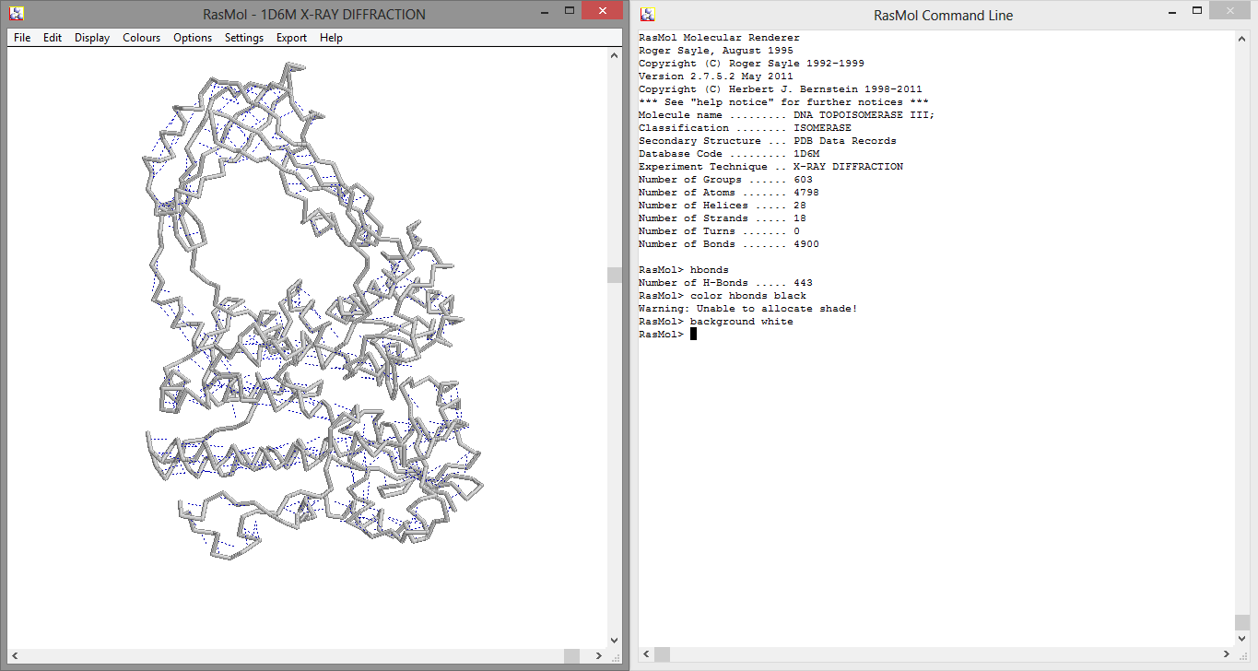
E. Coli DNA Topoisomerase III Structure.

Slide 32
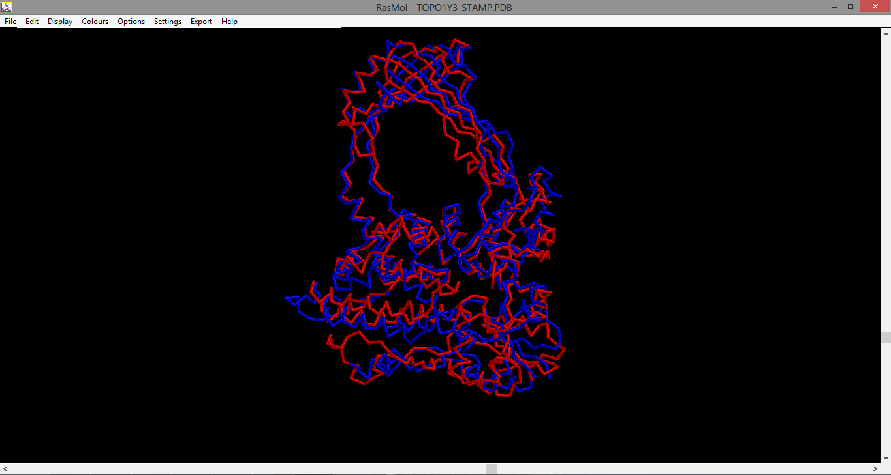
E. Coli DNA Topoisomerases I & III
Topoisomerase III
Topoisomerase I

Slide 33
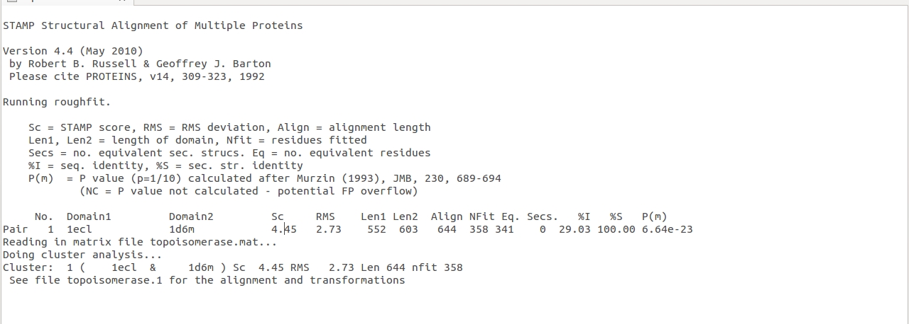
E. Coli DNA Topoisomerases I & III

Slide 34
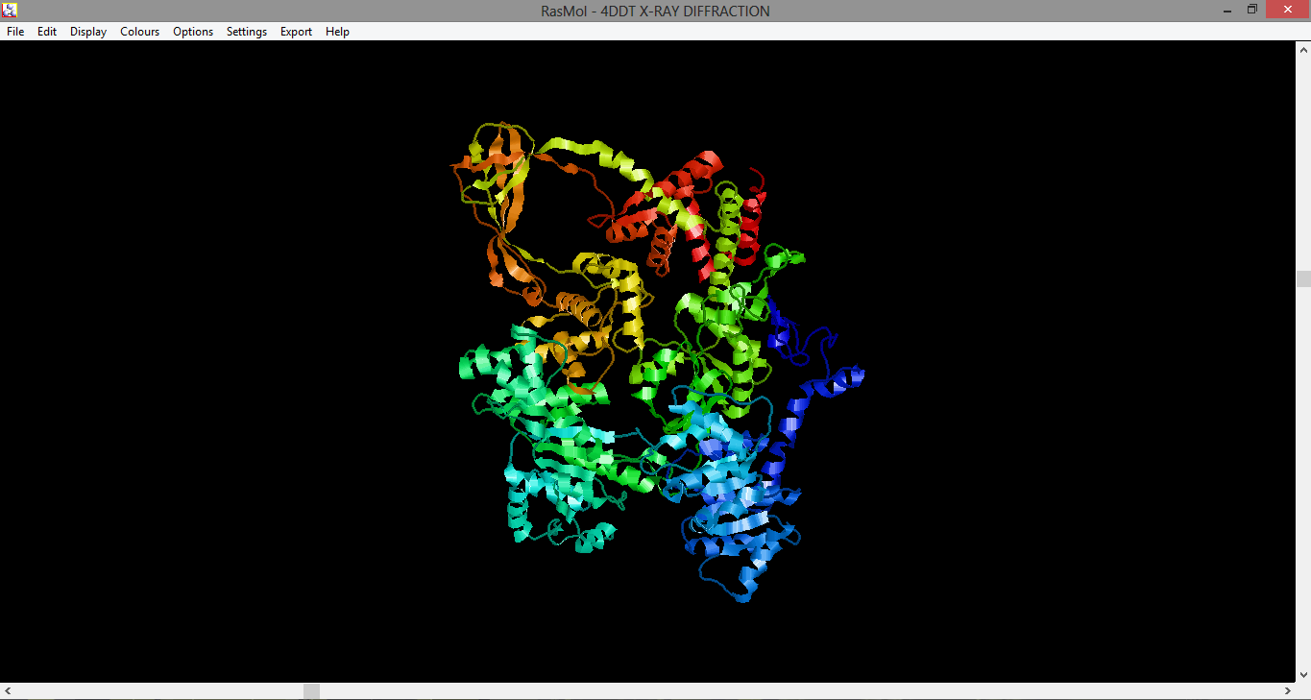
Reverse Gyrase. Protein

Slide 35
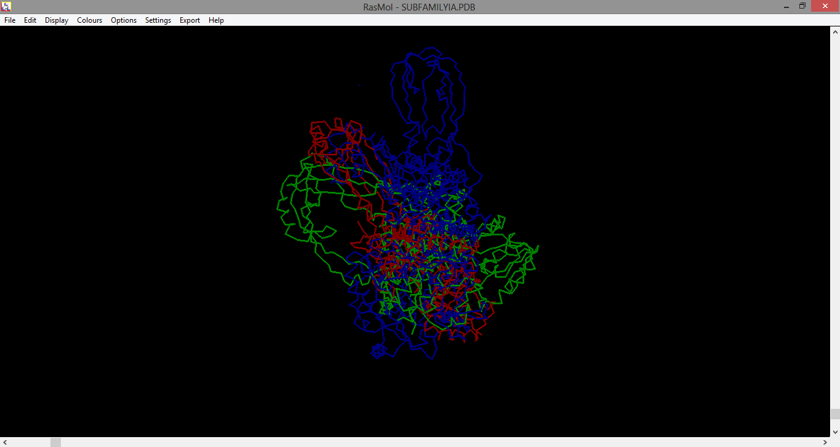
Type IA Subfamily superposition
Topoisomerase III
Topoisomerase I
Revers Gyrase

Slide 36
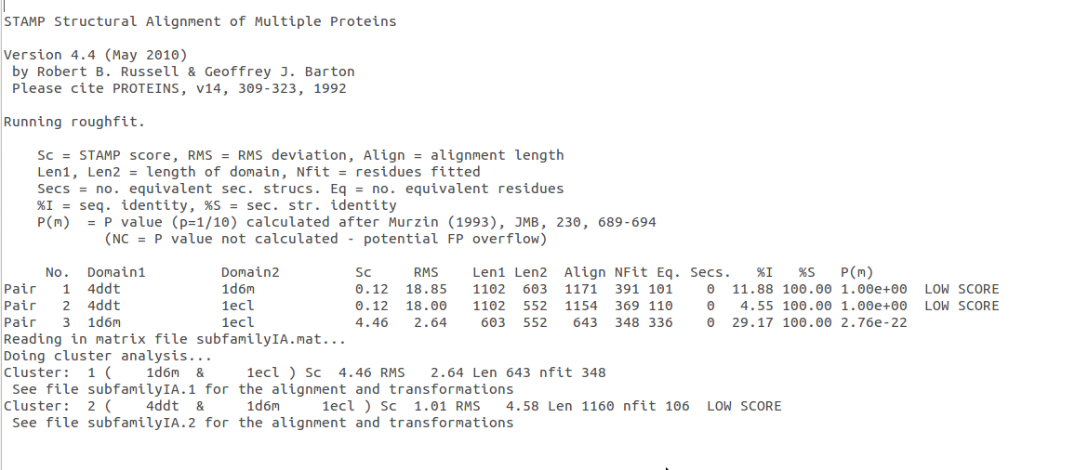
Type IA Subfamily. Stamp

Slide 37
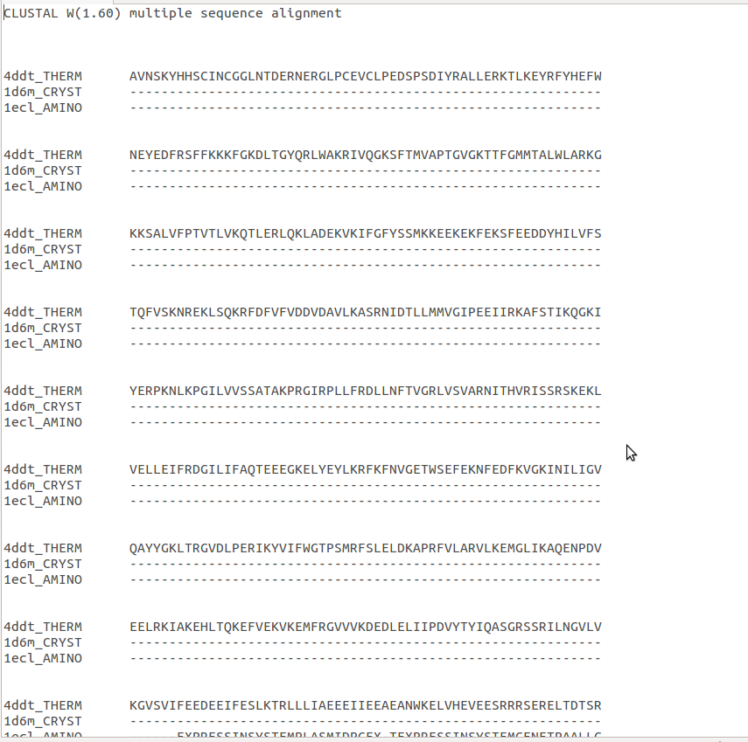
Type IA Subfamily. Alignment

Slide 38
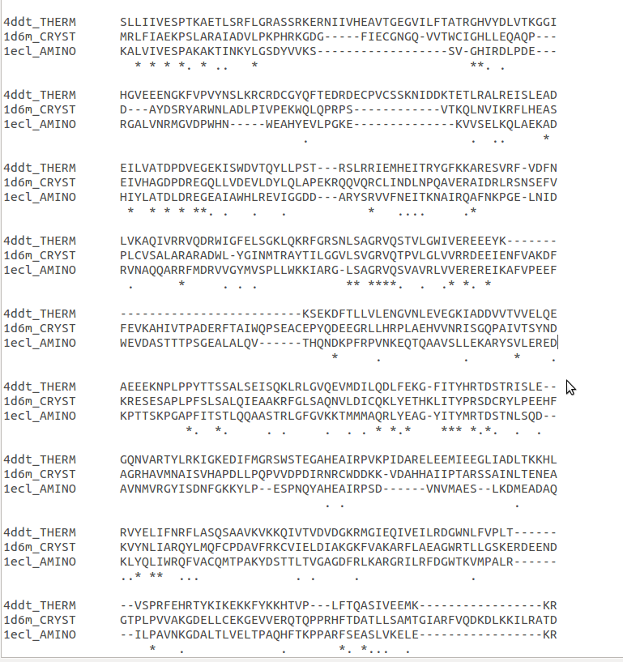
Type IA Subfamily. Alignment

Slide 39
Type IB DNA Topoisomerase General Features
The members of the type IB subfamily of topoisomerases I share no sequence or structural homology with other known topoisomerases and are functionally distinct from the members of the type IA subfamily.
The type IB subfamily members can relax both positive and negative supercoils, and relaxation goes to completion.
There is no requirement that the substrate DNA be at least partially single-stranded.
These enzyme bonds to 3’ rather than 5’ like type IA.
The enzymes contain no bound metal ions, and DNA relaxation does not require Mg(II).

Slide 40
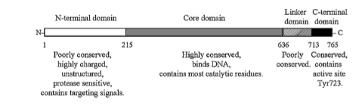
Human DNA Topoisomerase I. Structure

Slide 41
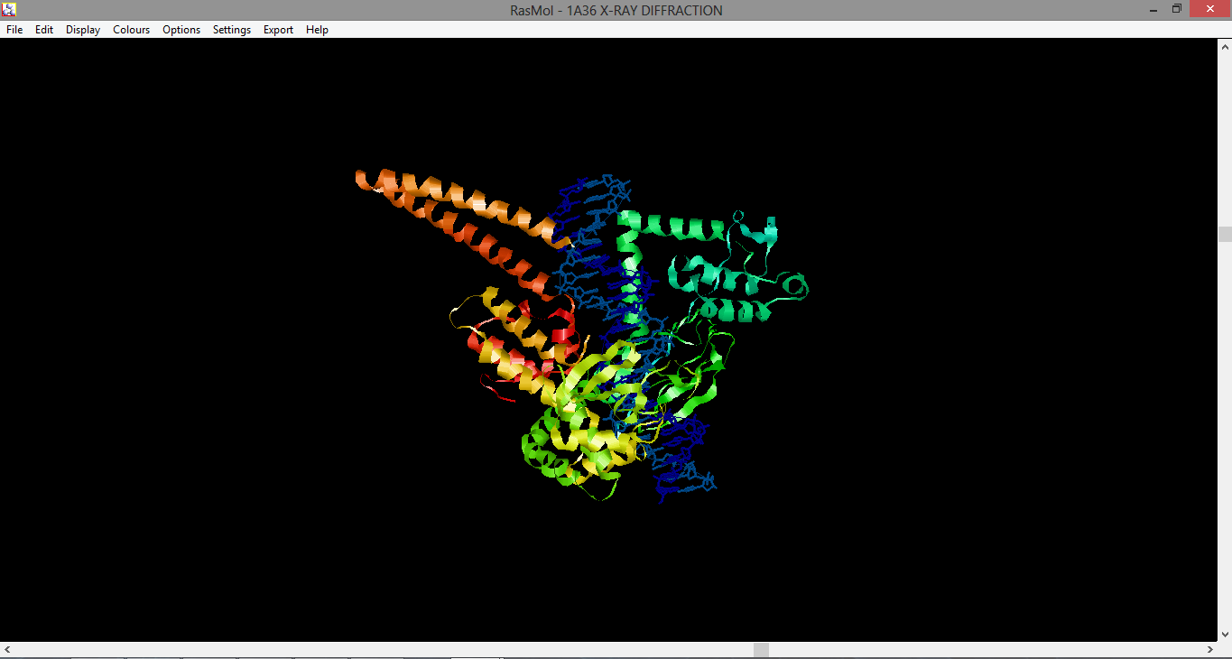
Human DNA Topoisomerase I. Structure

Slide 42
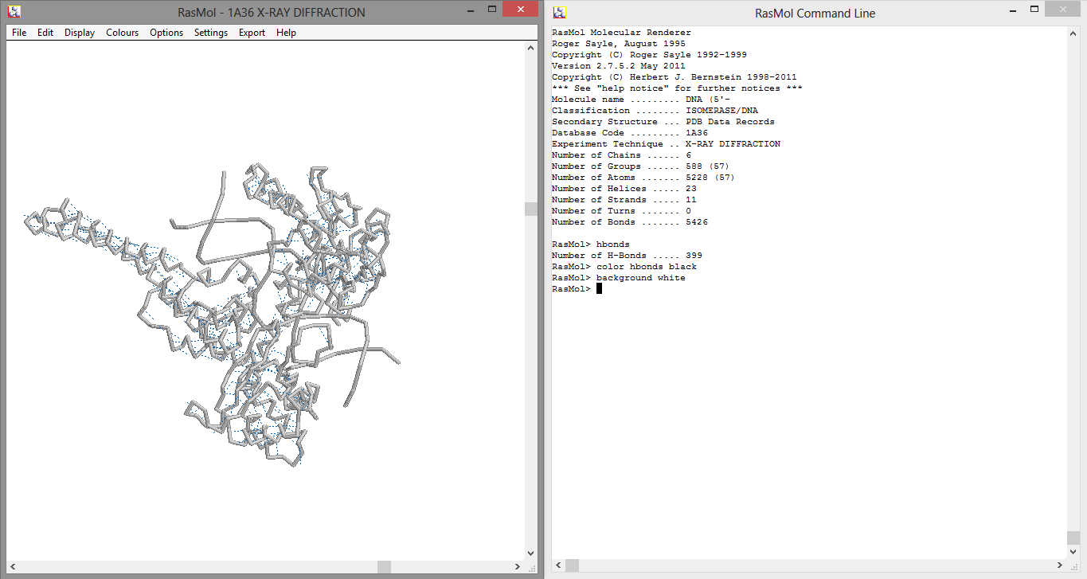
Human DNA Topoisomerase I. Structure

Slide 43
Type II DNA Topoisomerase General Features
The dimeric enzymes bind duplex DNA and cleave the opposing strands with a four base stagger.
Cleavage involves covalent attachment of each subunit of the dimer to the 5’ end of the DNA through a phosphotyrosine bond.
The reactions require Mg(II).
ATP hydrolysis is required for enzyme turnover and rapid kinetics.

Slide 44
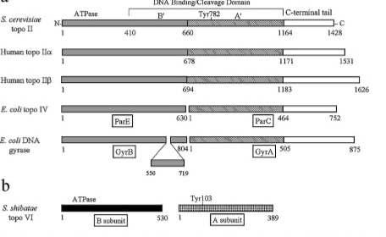
Type II DNA Topoisomerase.Structure

Slide 45
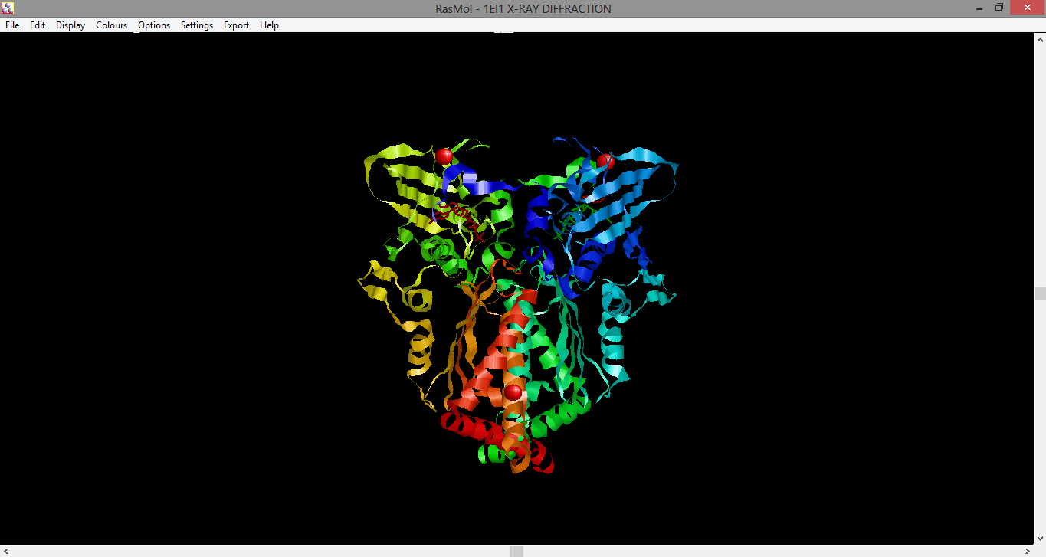
E. Coli Gyrase B subunit.

Slide 46
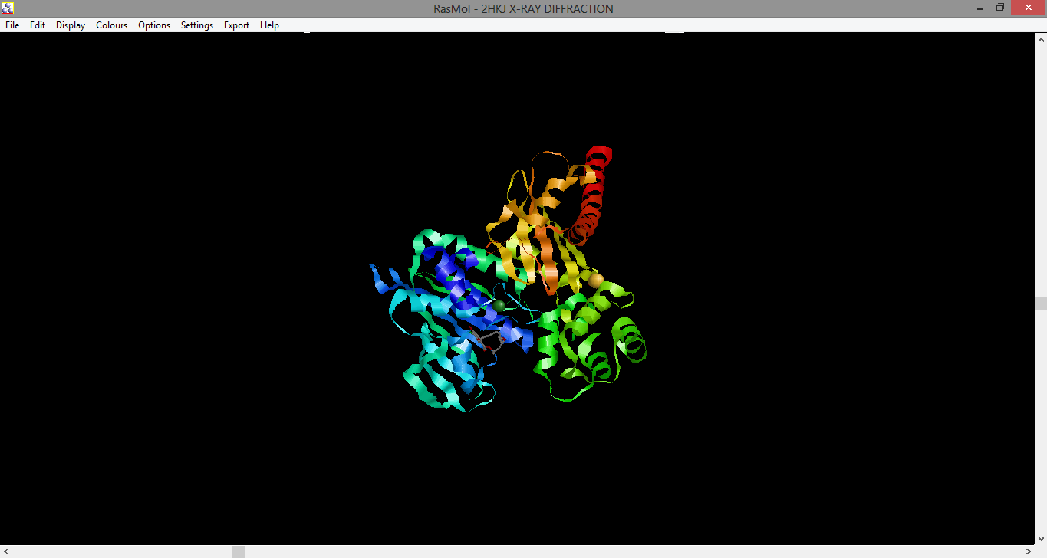
Type IIB DNA Topoisomerase.Structure S. Shibatae Topoisomerase VI-B

Slide 47
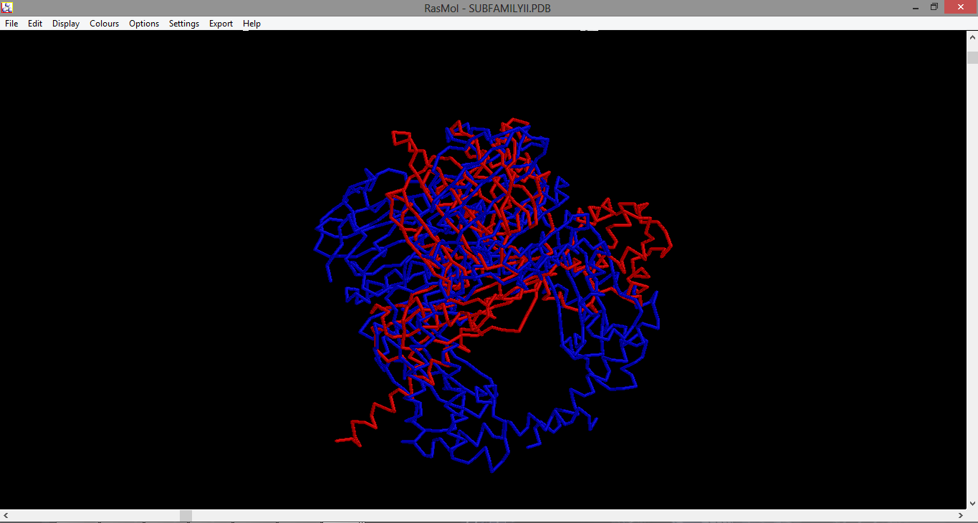
Type IIA & IIB superposition.

Slide 48
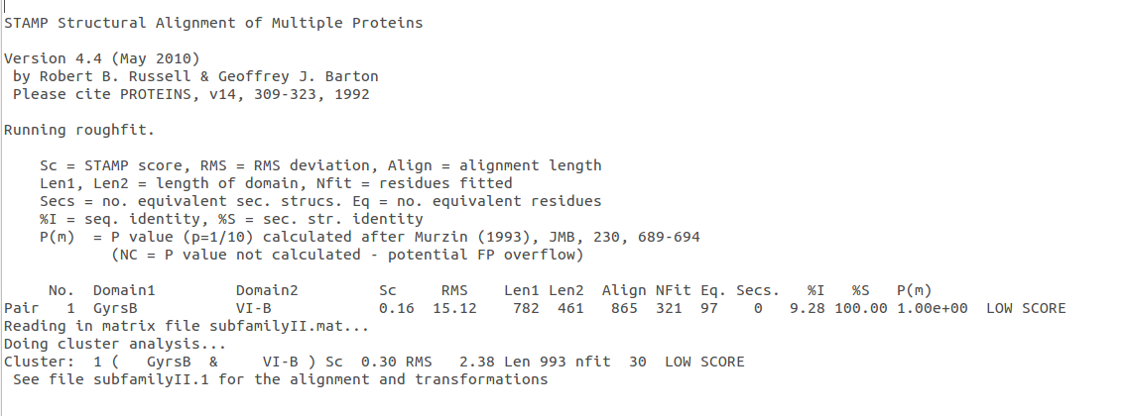
Type IIA & IIB Stamp.

Slide 49
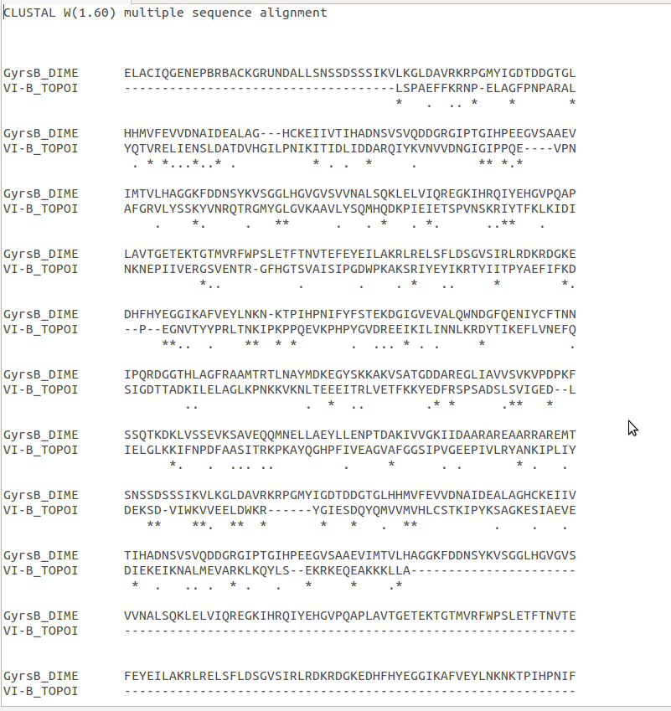
Type IIA & IIB Alignment.

Slide 50
Conclusions
Topoisomerase are a complex family and big one.
Rasmol and VMD are so different in use form.

Slide 51
PEM
1. How are the topoisomerases divided?
a)By molecular weight.
b)Subfamilies and there are four subfamilies.
c)By polarity interactions.
d)In plastic bag.
2. How the tyrosin of the topoisomerase does binds to DNA?
a)Phosphodiester bond.
b)H-bonds.
c)Creating salt bridges.
d)Magnetism.
3. Which of the next proteins are from IA subfamily?
a)E. coli topoisomerase I & II, Reverse gyrase.
b)Hemoglobin and leucocytes.
c)Human Topoisomerase I.
d)Topoisomerase VI-B subunit.
4. Which of the next sentences is correct:
a)DNA does not need replication.
b)Topoisomerases are chemicals compounds.
c)The catalytic part of topoisomerases contain tyrosin residue, which binds to DNA.
d)The structure of E. colo topoisomerase I is similar to a flattened cat.
5. Why subfamily IIA and IIB are similar?
a) They are homologus.
b) They are folded as the same form.
c) They love magnesium.
d) Because they have ATP dependent dominion.

Slide 52
1. What is the basic difference between topoisomerase I and topoisomerase II?
A)Topoisomerase I create a nick on the one of stand and type II topoisomerase breaks both of strands of DNA.
B)topoisomerase I just exist in the prokaryotic cells, while only eukaryotes have type II topoisomerase .
C)Topoisomerase I is dimeric protein, while topoisomerase II is monemeric enyzemes.
D) Their optimal environmental conditions are different from each other.
2. what is diferent nucleophilic atack between topoisomerase IB and other subfamilies?
a)Topoisomerase IB arginine residues attack to oxygen of phosphate so they are plays roles in catalytic activity.
b)Topoisomerase IB rediues helps to stabilize phosphate of DNA after cleavage so they don’t need cofactor such as Mg for nuclecphilic attack.
c)Topoisomerase IB cleaves DNA molecules on more specific sites.
d)Other all subfamilies need ATP to attack oxygen of phosphate, while topoisomerase IB is ATP independent enzymes.
3. Where does topoisomerase I play essential role?
A) Cellular process like replication and transcription B) Cellular transection and segregation of chromosomes into daughter cell C) Cell division and cellular process D) Storage of DNA in nucleus
4.What is the common residue amoung topoisomerase family?
A) glutamate residues catalyze DNA cleavage. B) tyrosine residue help to undergoes confermational changes. C) tyrosine residue provides to cayalyze cleavage of DNA.
D) arginine residue attack to oxygen of phosphate .
5. How is it possible to observe about structure of active sites on the different topoisomerase?
A) By examining domains of topoisomerase
B) By compraring mechanism
C) Just about googlıng
D) Rasmol provides to choose the numbers of residue.

Slide 53
References.
Champoux, J. J. (2001). DNA TOPOISOMERASES: Structure, Function, and Mechanism. Biochemestry, 70, 369 - 413.
Corbett K.D. and James M. Berger J.M., STRUCTURE, MOLECULARMECHANISMS, AND EVOLUTIONARY RELATIONSHIPS IN DNA TOPOISOMERASES, Department of Molecular and Cellular Biology, University of California, Berkeley, California 94720; email: korbett@uclink.berkeley.edu, jmberger@uclink.berkeley.edu
James C. Wang, DNA Topoisomerases: Why So Many?, From the Department of Biochemistry and Molecular Biology, Harvard University, Cambridge, Massachusetts 02138
Kresge N.,Simoni R.D. & Hill R. , the Work of James C. Wang Unwinding the DNA Topoisomerase Story, J. Biol. Chem. 2007, 282:e17
Perry K.. & Mondrago A. , Structure of a Complex between E. Coli DNA Topoisomerase I and Single-Stranded DNA, Department of Biochemistry, Molecular Biology,and Cell Biology,Northwestern University Evanston, Illinois 60208

Slide 54
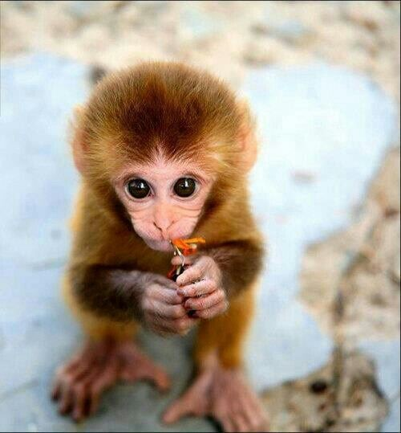
THANKS FOR YOUR ATTENTION.
PD. Don’t be mean with questions.

