Slide 1
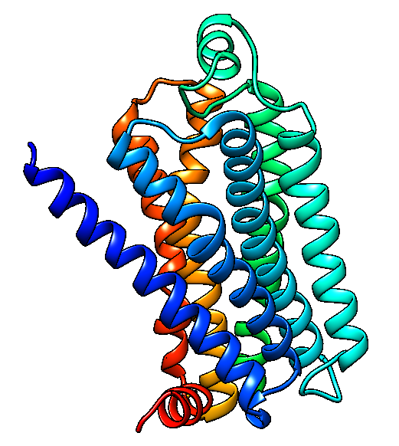
G-Protein coupled receptors
B2 adrenergic receptor
Ainoa Forteza, Jaume Minoves, Ester Moya, Isshak Mrabet
Structural Biology

Slide 2
INDEX
Introduction
X-ray
Evolution
Structure
  Inverse Agonist
  Agonist
Comparisons
  Active – inactive
  GPCRs
References

Slide 3
MAIN FACTORS DETERMINING PROTEIN FOLDING
X-RAY EVOLUTION STRUCTURE COMPARISONS
INTRO
Main factors in protein folding
AA sequence
H bonds
Van der Waals forces
Electrostatic interactions
Postraductional modifications
Hidrophobic interactions
INTEGRAL MEMBRANE PROTEINS
b-SHEETS- Barrels (porins)
Transmembrane alfa-helices

Slide 4
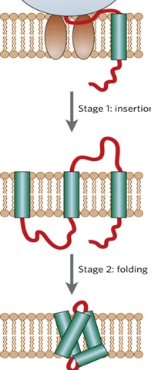
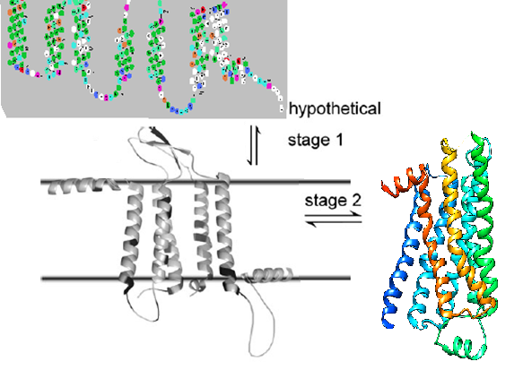
Two-stage model of protein folding
X-RAY EVOLUTION STRUCTURE COMPARISONS
INTRO
The hydrophobic effect is a major driving force in the folding of water-soluble proteins
·First stage: membrane insertion and secondary structure formation
·Second stage: helix–helix interactions
Image source: James U. Bowie. Solving the membrane protein folding problem. Nature. 2005; 438: 581-589.

Slide 5
ARQUITECTURE OF MEMBRANE PROTEINS
X-RAY EVOLUTION STRUCTURE COMPARISONS
INTRO
Interhelical hydrogen bonds
Small residues and tigh helix packing
Aromatic interactions
Ion pairs
Other parameters
Lateral pressure profile
Architecture of membrane proteins
Specific lipid effects
Hidrophobic match/mismatch

Slide 6
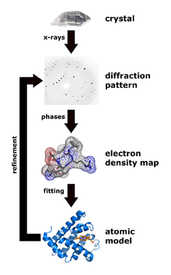
X-RAY CRYSTALLOGRAPHY
X-RAY EVOLUTION STRUCTURE COMPARISONS
INTRO
X-RAY
1) Mounting the crystal
2) X-ray generators
3) Record with photographic film or charge-coupled device (CCD) image sensor
4) Data analysis
5) Data processing
6) Model building and refinement

Slide 7
PROTEIN CRYSTALOGRAPHY
X-RAY EVOLUTION STRUCTURE COMPARISONS
INTRO
X-RAY
Challenges
Strategies used to solve them
Expression
Solubilization
Purification
Crystallization
Data collection
Structure solution
Protein purification
Use of chimeras and mutations
Improving crystallography techniques of GPCR´s
Limitations
Post-translational modifications not incorporated during purification
Truncations of loops and N-t or C-t
Chimeras, mutations or the use of antibodies affect the mobility of the TM helices
Expression of the protein

Slide 8
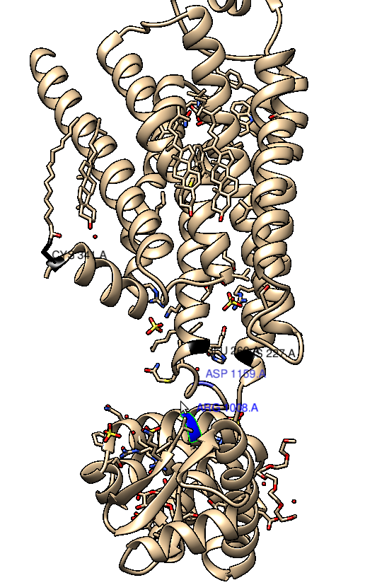
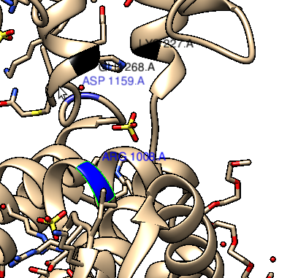
Heteroatoms used in the crystallization
X-RAY EVOLUTION STRUCTURE COMPARISONS
INTRO
X-RAY

Slide 9
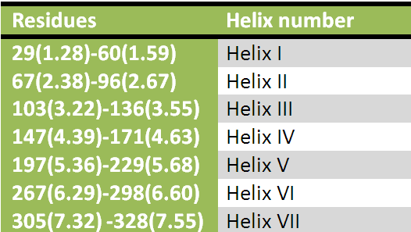
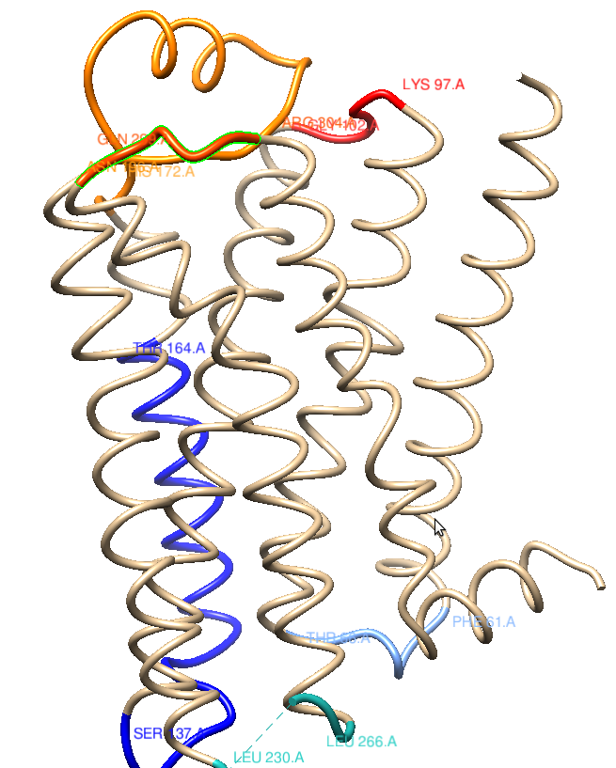
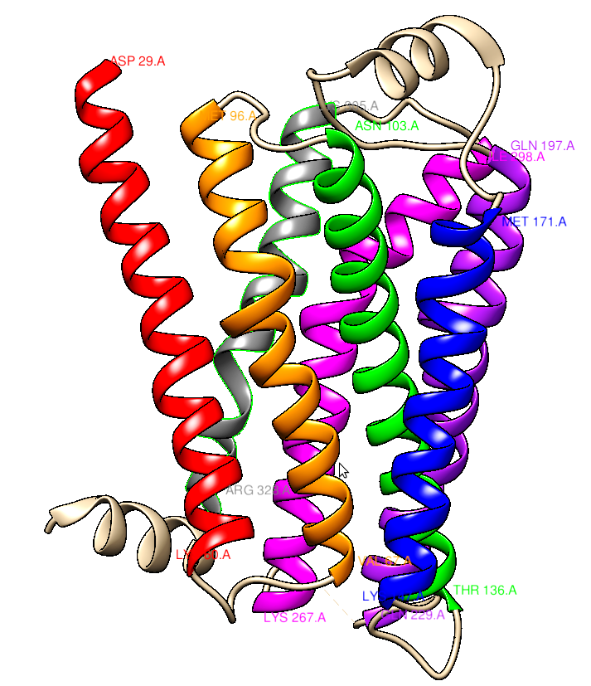
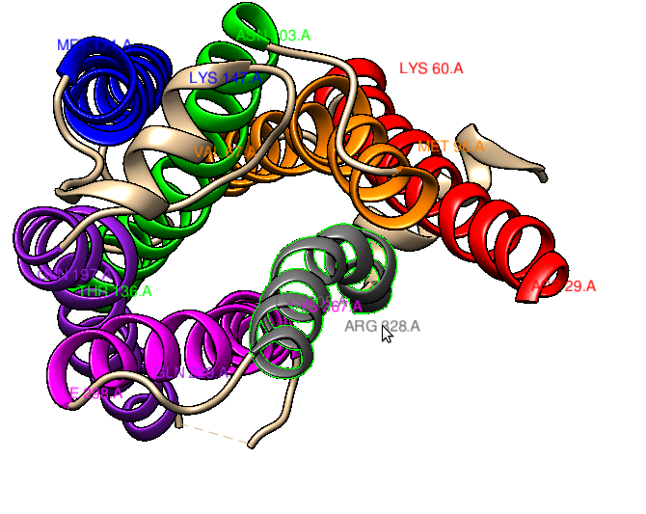
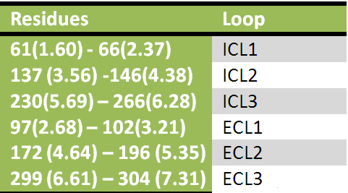
LOOPS AND HELICES
X-RAY EVOLUTION STRUCTURE COMPARISONS
INTRO
X-RAY

Slide 10
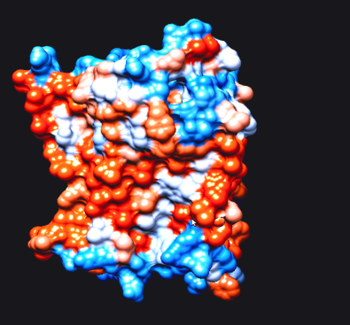
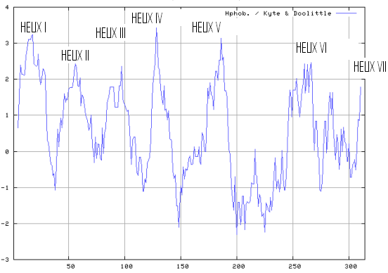
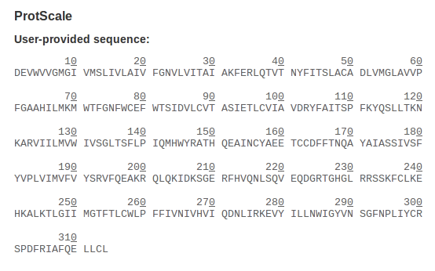
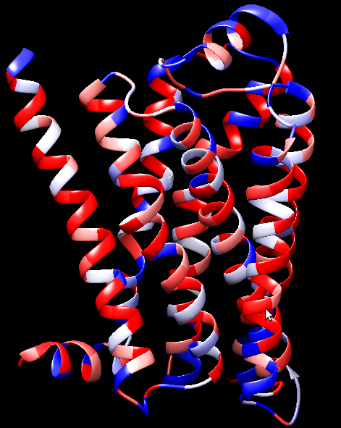
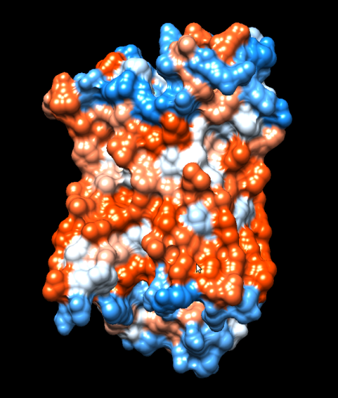
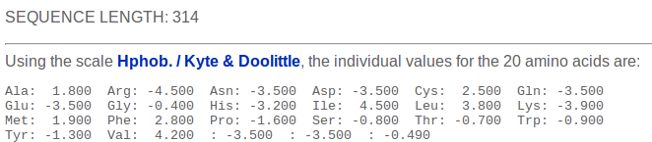
HYDROPHOBICITY PLOT
X-RAY EVOLUTION STRUCTURE COMPARISONS
INTRO
X-RAY

Slide 11
HOMOLOGY STUDY
X-RAY EVOLUTION STRUCTURE COMPARISONS
INTRO
EVOLUTION
Pdb label 2RH1
Obtain target sequence
hmmscan PFAM-A
hmmfetch (HMM)
hmmsearch (Uniprot)
Select templates
hmmalign
Transform to clustalW
Phylogenic tree

Slide 12
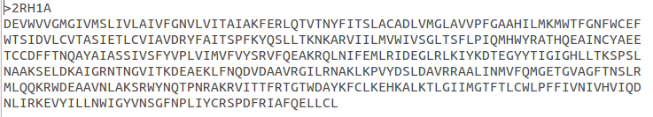
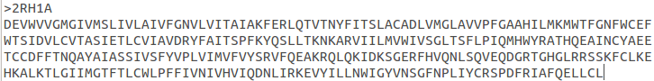
HOMOLOGY STUDY
X-RAY EVOLUTION STRUCTURE COMPARISONS
INTRO
EVOLUTION
T4 Phage sequence
ICL-3 start and end

Slide 13
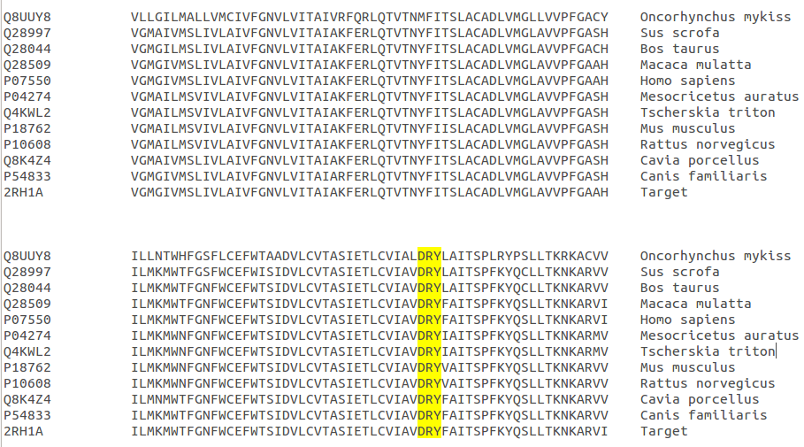
HOMOLOGY STUDY
X-RAY EVOLUTION STRUCTURE COMPARISONS
INTRO
EVOLUTION
Tm-helix1
Tm-helix2
ICL-1
Tm-helix2
Tm-helix3
Tm-helix4
ECL-1
ICL-2

Slide 14
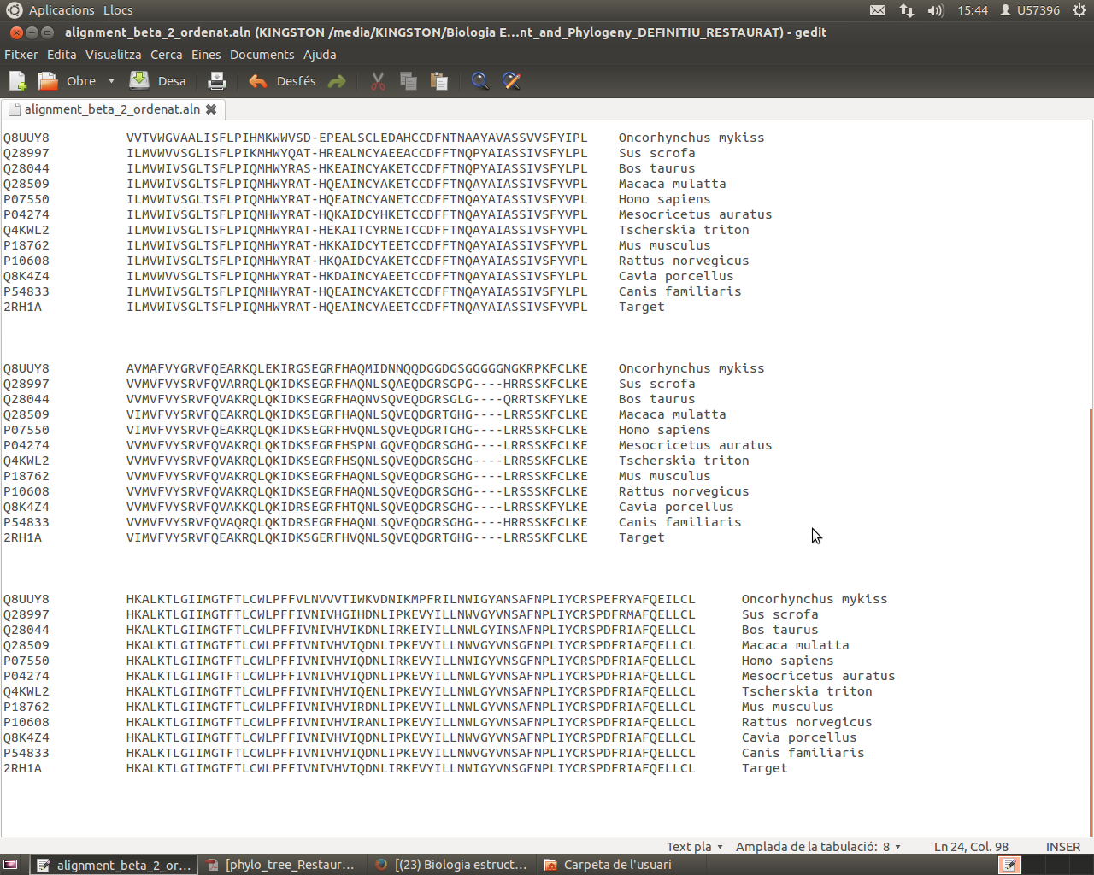
HOMOLOGY STUDY
X-RAY EVOLUTION STRUCTURE COMPARISONS
INTRO
EVOLUTION
Tm-helix4
Tm-helix5
ECL-2
Tm-helix5
Tm-helix6
ICL-3

Slide 15
HOMOLOGY STUDY
X-RAY EVOLUTION STRUCTURE COMPARISONS
INTRO
EVOLUTION
Tm-helix6
Tm-helix7
ECL-3

Slide 16
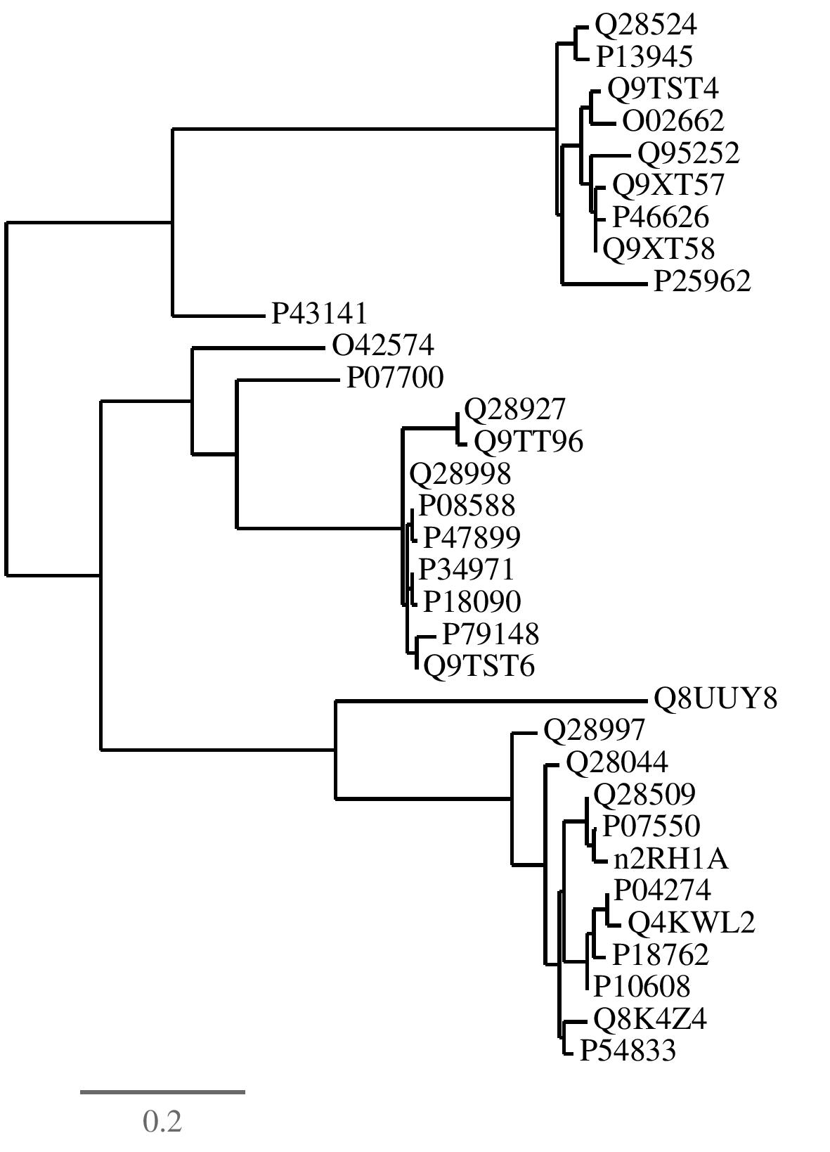
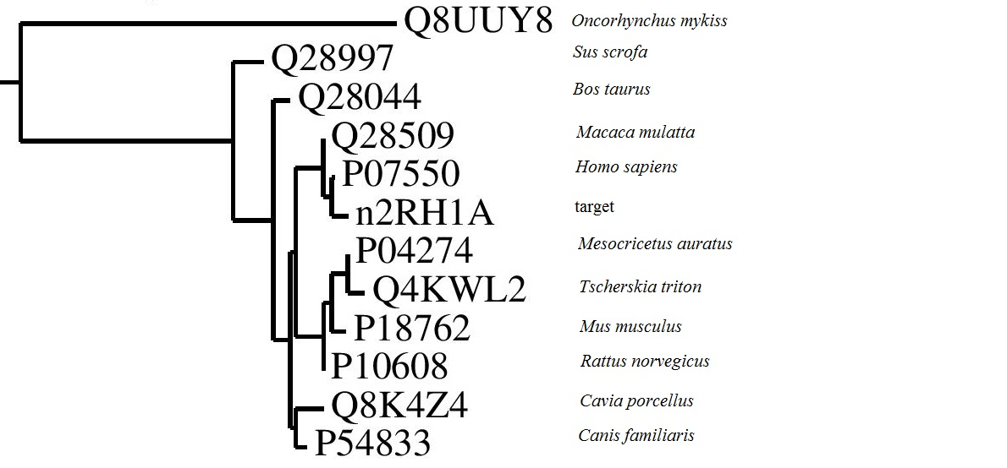
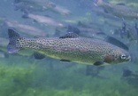





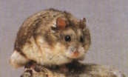




PHYLOGENIC TREE
X-RAY EVOLUTION STRUCTURE COMPARISONS
INTRO
EVOLUTION

Slide 17
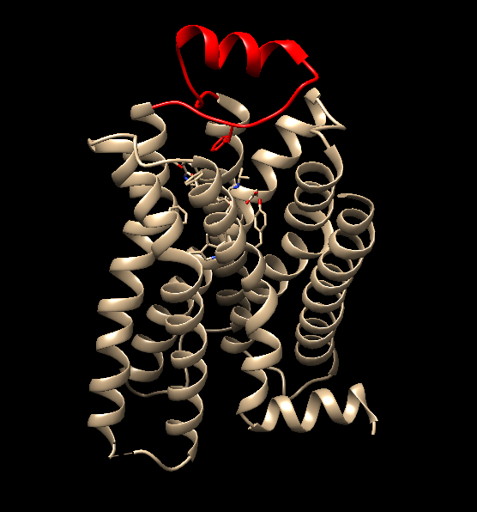
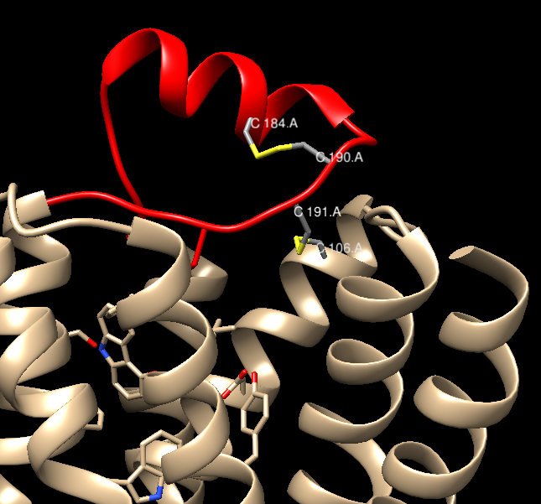
INVERSE AGONIST - CARAZOLOL
X-RAY EVOLUTION STRUCTURE COMPARISONS
INTRO
STRUCTURE
Disulfide bridges

Slide 18
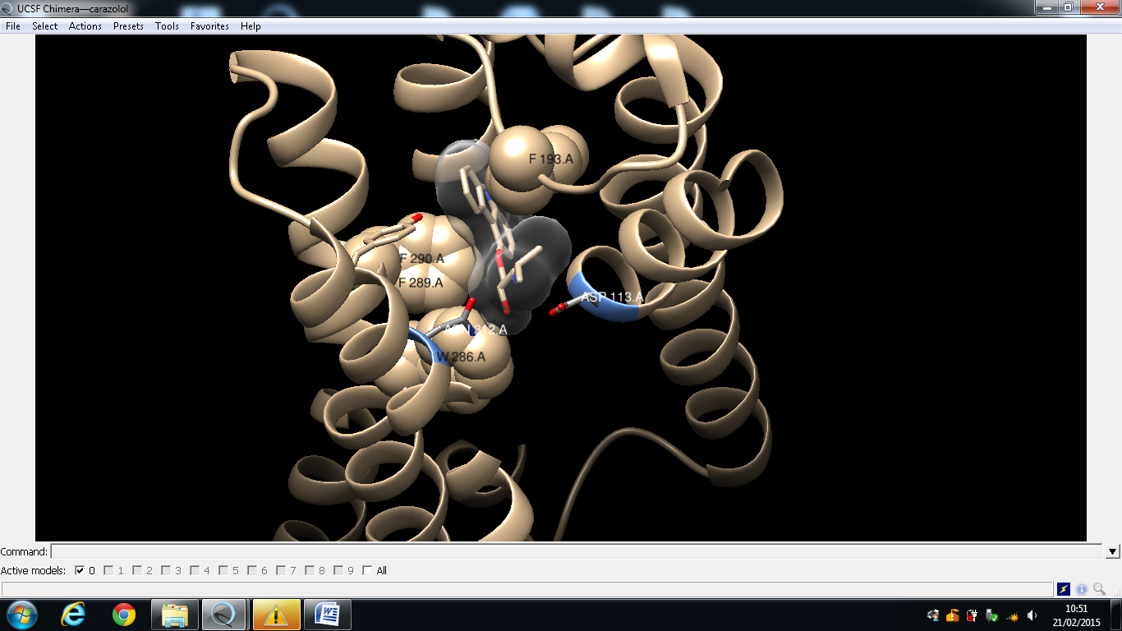
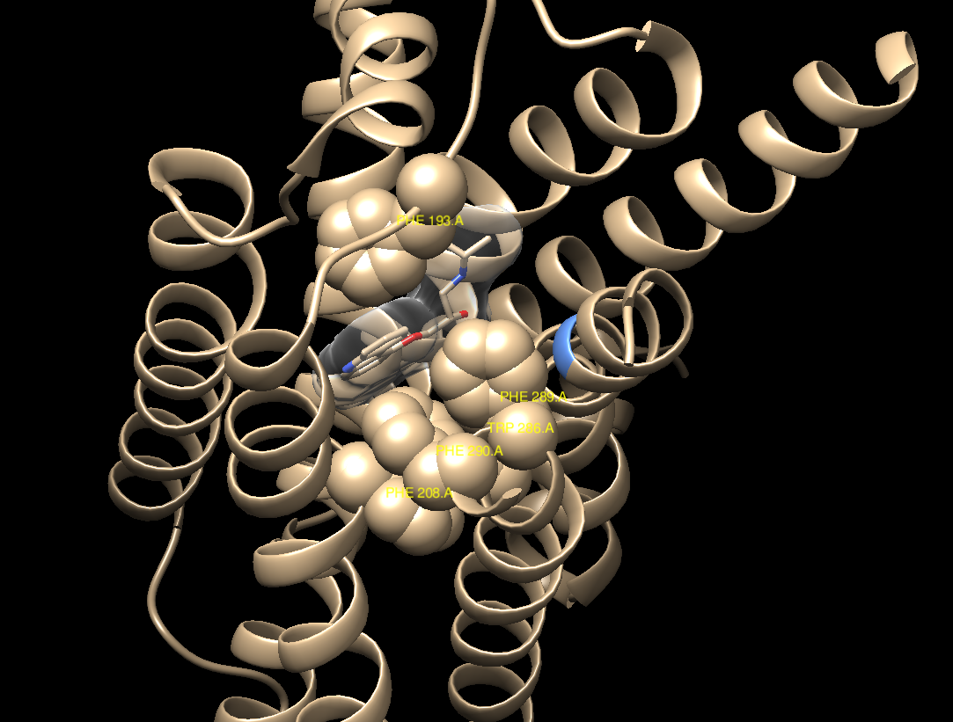
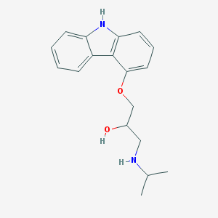
INVERSE AGONIST - CARAZOLOL
X-RAY EVOLUTION STRUCTURE COMPARISONS
INTRO
STRUCTURE
Aromatic interactions

Slide 19
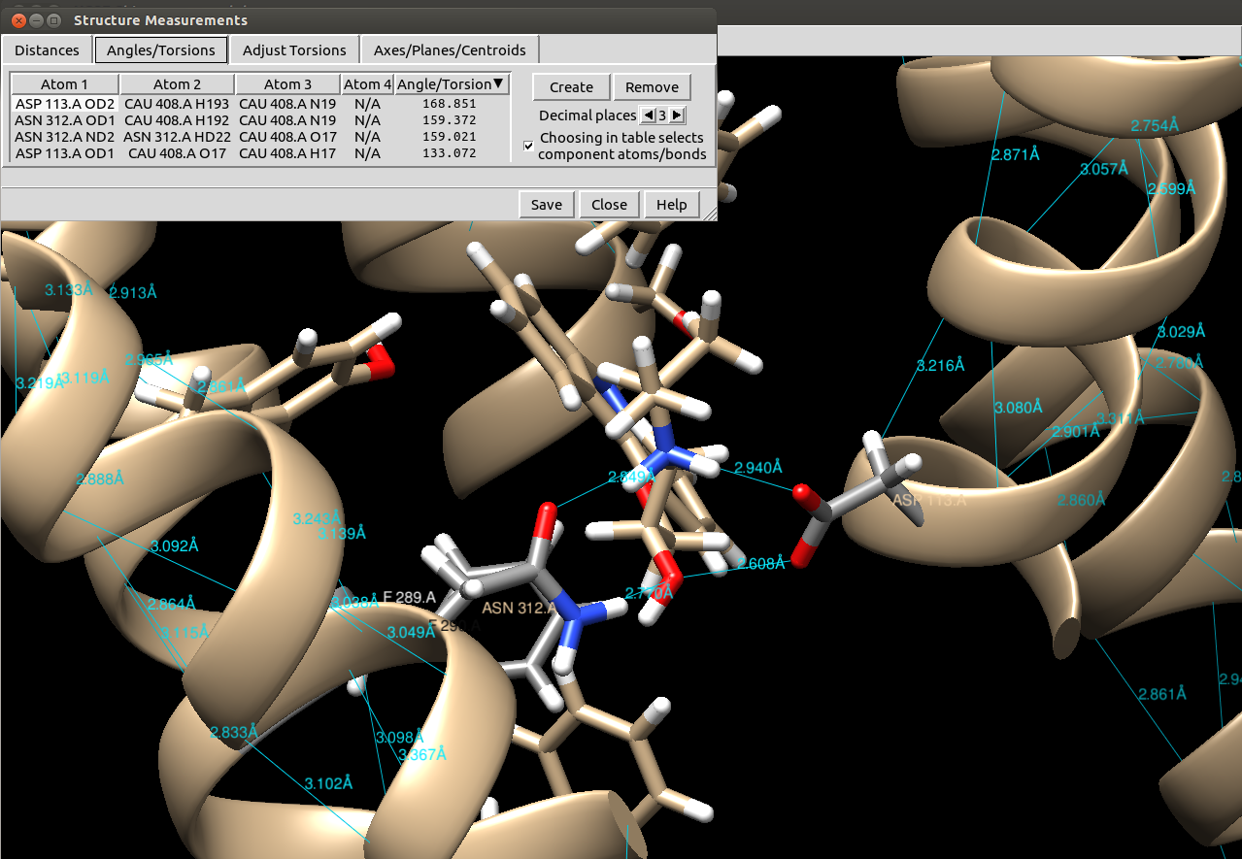
INVERSE AGONIST - CARAZOLOL
X-RAY EVOLUTION STRUCTURE COMPARISONS
INTRO
STRUCTURE
Polar interactions – Hydrogen bonds
Asp113

Slide 20
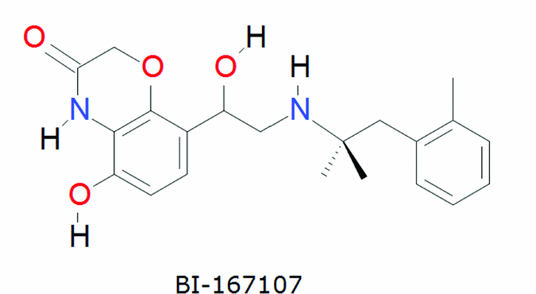
Agonist – BI-167107
X-RAY EVOLUTION STRUCTURE COMPARISONS
INTRO
STRUCTURE

Slide 21
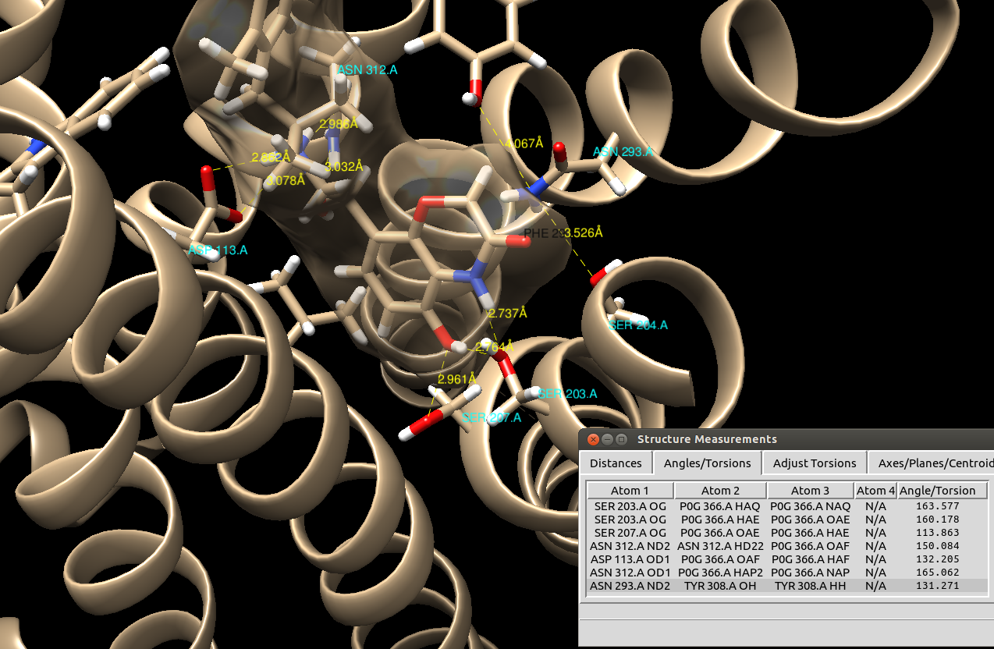
Agonist – BI-167107
X-RAY EVOLUTION STRUCTURE COMPARISONS
INTRO
STRUCTURE
Polar interactions – Hydrogen bonds

Slide 22
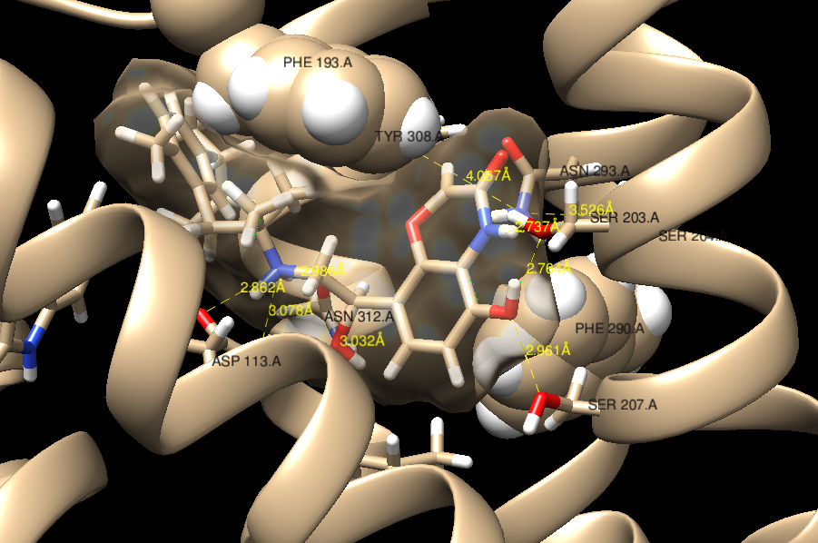
Agonist – BI-167107
X-RAY EVOLUTION STRUCTURE COMPARISONS
INTRO
STRUCTURE
Serine network

Slide 23
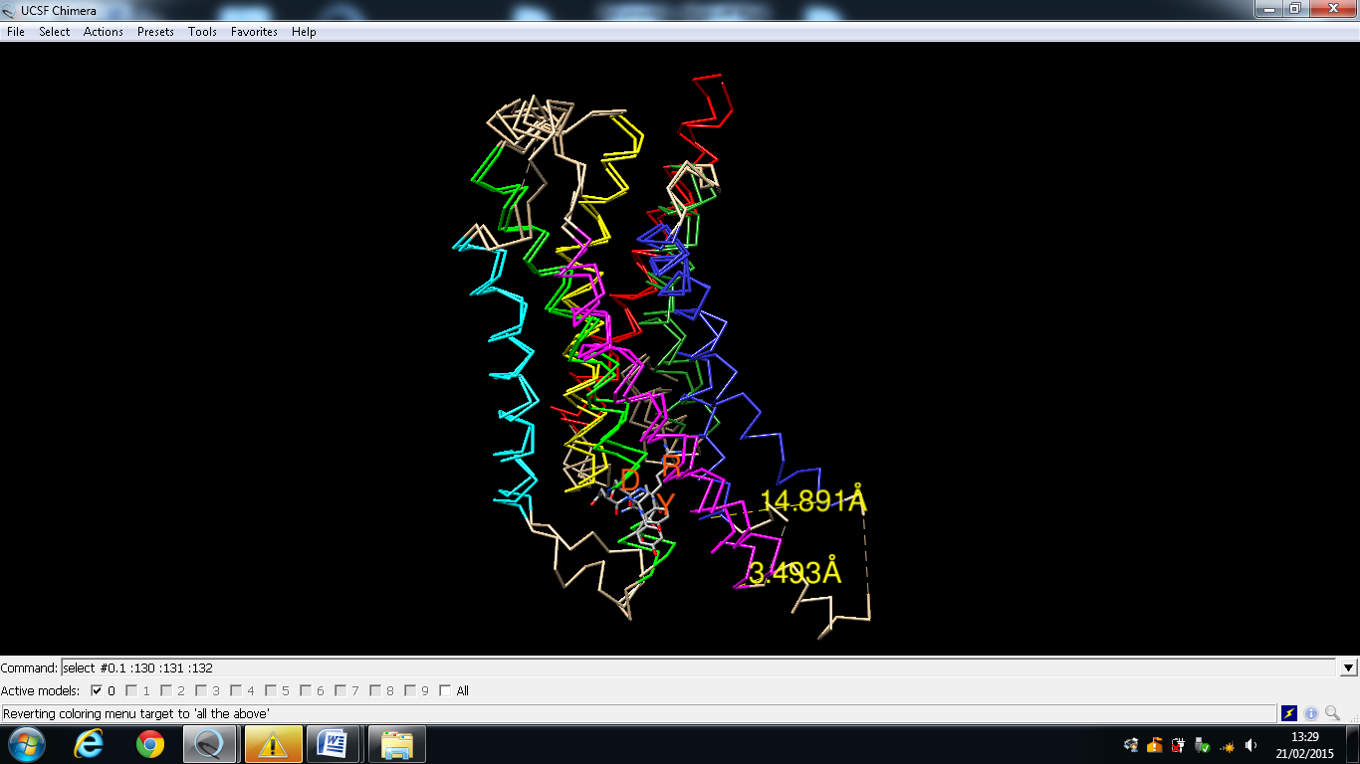
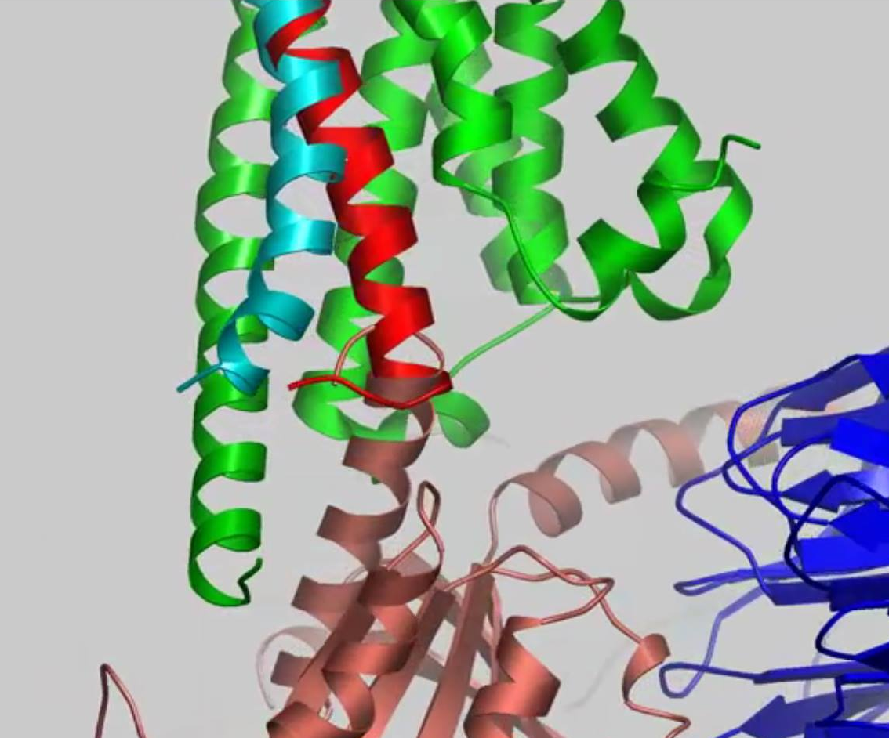
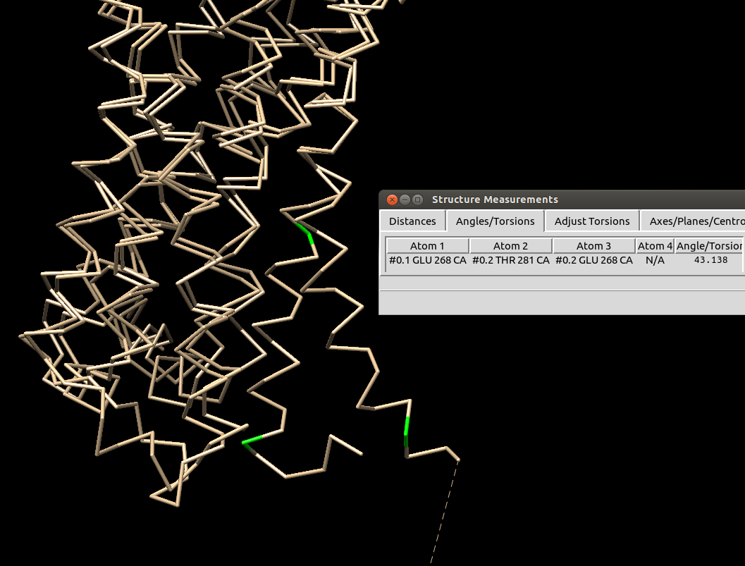
INACTIVE VS ACTIVE STATE
X-RAY EVOLUTION STRUCTURE COMPARISONS
INTRO
COMPARISONS
Image source: http://www.ebi.ac.uk/pdbe/quips?story=B2AR

Slide 24
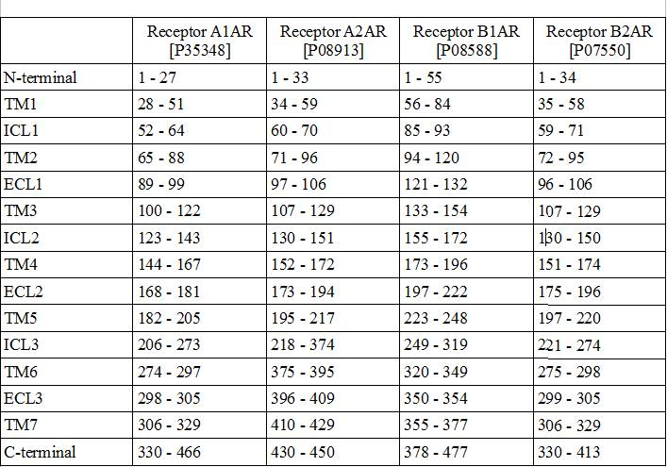
COMPARISON A1-A2-B1-B2
X-RAY EVOLUTION STRUCTURE COMPARISONS
INTRO
COMPARISONS

Slide 25
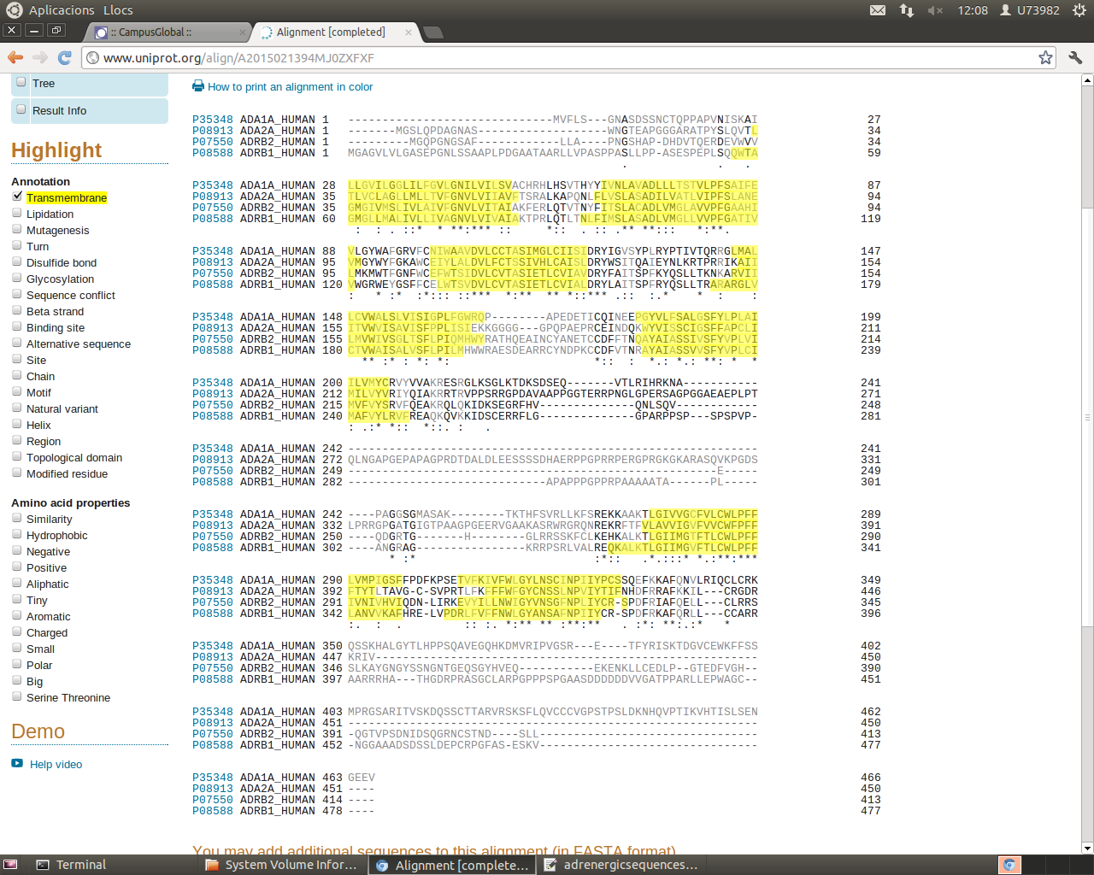
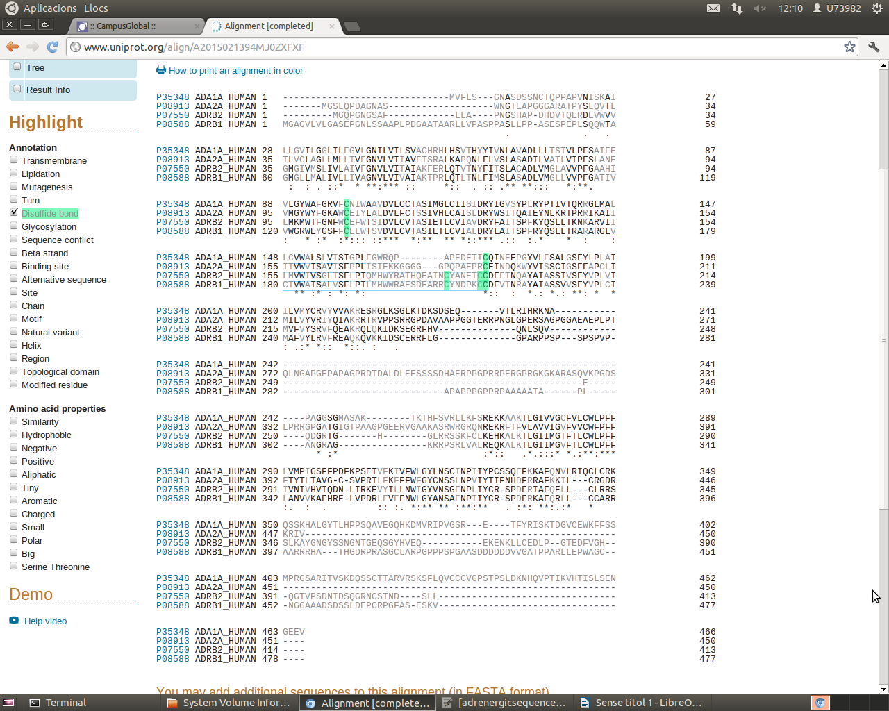
COMPARISON A1-A2-B1-B2
X-RAY EVOLUTION STRUCTURE COMPARISONS
INTRO
COMPARISONS

Slide 26
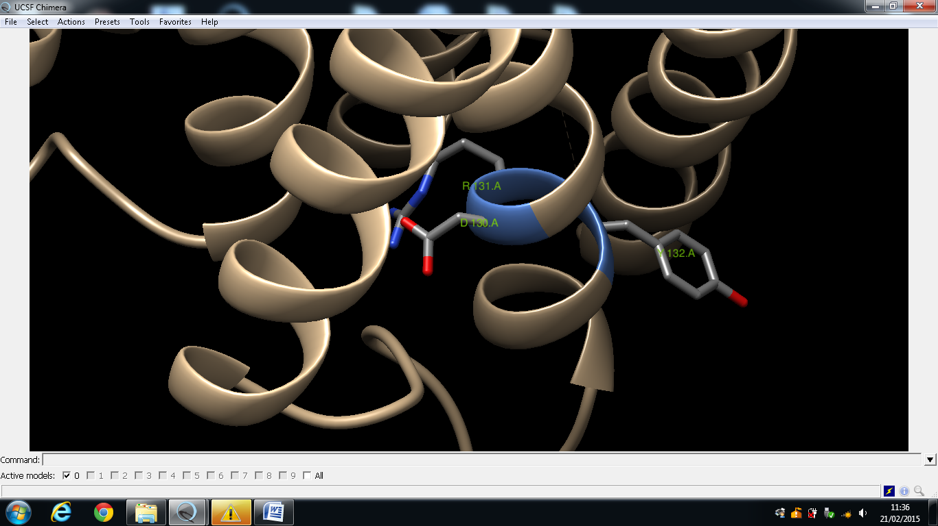
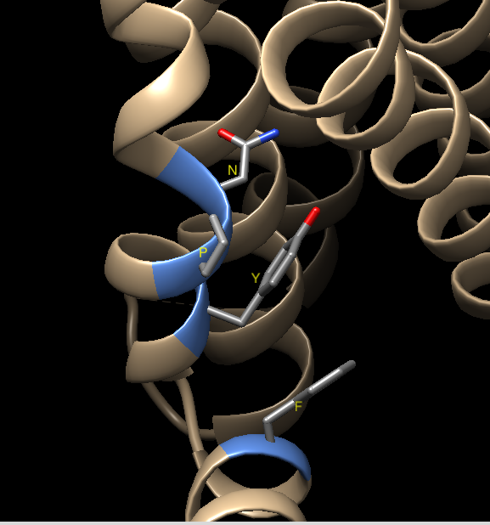
Conserved motives
X-RAY EVOLUTION STRUCTURE COMPARISONS
INTRO
STRUCTURE
dry
NPxxY(x)₅F

Slide 27
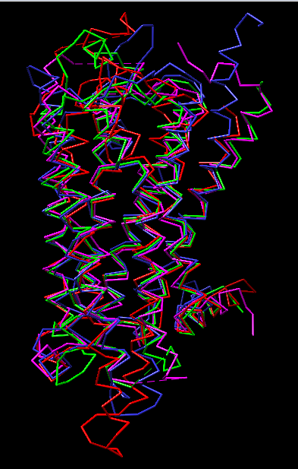
DIFFERENT GPCRs
X-RAY EVOLUTION STRUCTURE COMPARISONS
INTRO
COMPARISONS
Opioid: δ-OR (4N6H)
Adenosine: A2A (3VG9)
Serotonin: 5-HT1B (4IAR)
Adrenergic: B2AR (2RH1)
RMSD: 1.63
Sc: 7.56

Slide 28
REFERENCES
Bourne HR. How receptors talk to trimeric G proteins. Current Opinion in Cell Biology. 1997 Apr; 9(2): 134-42.
Cherezov V, Rosenbaum DM, Hanson MA, Rasmussen SGF, Thian FS, Kobilka TS, et al. High Resolution Crystal Structure of an Engineered Human β 2 - Adrenergic G protein-Coupled Receptor. Science. 2007 Nov; 318(5854): 1258–65.
Costanzi S. Homology Modeling of Class A G Protein-Coupled Receptors. Methods Mol Biol. 2012; 857: 259-79
Deupi X, Standfuss J. Structural insights into agonist-induced activation of G-protein-coupled receptors. Current Opinion in Structural Biology. 2011 Aug; 21(4): 541-51
Fritze O, Filipek S, Kuksa V, Palczewski K, Hofmann KP, Ernst OP. Role of the conserved NPxxY(x)5,6F motif in the rhodopsin ground state and during activation. Proc Natl Acad Sci U S A. 2003 Mar; 100(5): 2290-5
Goldfeld DA, Zhu K, Beuming T, Friesner RA. Loop prediction for a GPCR homology model: Algorithms and results. Proteins Struct Funct Bioinforma. 2013 Feb; 81(2): 214-28
Hanson MA, Cherezov V, Griffith MT, Roth CB, Jaakola VP, Chien EYT, et al. A Specific Cholesterol Binding Site Is Established by the 2.8 A Structure of the Human beta2-Adrenergic Receptor. Structure. 2008 Jun; 16(6): 897-905
Hill SJ. G-protein-coupled receptors: past, present and future. Br J Pharmacol. 2006 Jan; 147 Suppl 1:S27-37
Ji TH, Grossmann M, Ji I. G protein-coupled receptors I. Diversity of receptor-ligand interactions. J Biol Chem. 1998 Jul;273(28):17299-322
Johnston JM, Filizola M. Showcasing modern molecular dynamics simulations of membrane proteins through G protein-coupled receptors. Curr Opin in Struct Biol. 2011 Aug;21(4):552-8
Katritch V, Reynolds KA, Cherezov V, Hanson MA, Roth CB, Yeager M, et al. Analysis of full and partial agonists binding to beta2-adrenergic receptor suggests a role of transmembrane helix V in agonist-specific conformational changes. J Mol Recognit 2009. 22(4):307–18

Slide 29
REFERENCES
Latek D, Modzelewska A, Trzaskowski B, Palczewski K, Filipek S. G protein-coupled receptors-recent advances. Acta Biochim Pol. 2012;59(4):515-29
Lohse MJ, Maiellaro I, Calebiro D. Kinetics and mechanism of G protein-coupled receptor activation. Curr Opin Cell Biol. 2014 Apr;27:87-93
Manglik A, Kobilka B. The role of protein dynamics in GPCR function: Insights from the beta2AR and rhodopsin. Curr Opin Cell Biol. 2014 Apr;27:136-43
Rasmussen SGF, Choi H-J, Rosenbaum DM, Kobilka TS, Thian FS, Edwards PC, et al. Crystal structure of the human beta2 adrenergic G-protein-coupled receptor. Nature. 2007 Nov;450(7168):383-7
Rasmussen SGF, DeVree BT, Zou Y, Kruse AC, Chung KY, Kobilka TS, et al. Crystal structure of the β2 adrenergic receptor–Gs protein complex. Nature. 2011 Jul;477(7366):549-55
Rosenbaum DM, Rasmussen SGF, Kobilka BK. The structure and function of G-protein-coupled receptors. Nature. 2009;459:356–63
Rosenbaum DM, Zhang C, Lyons JA, Holl R, Aragao D, Arlow DH, et al. Structure and function of an irreversible agonist-β(2) adrenoceptor complex. Nature. 2011 Jan;469(7329):236-40
Topiol S, Sabio M. X-ray structure breakthroughs in the GPCR transmembrane region. Biochem Pharmacol. 2009 Jul;78(1):11–20
Vardy E, Roth BL. Conformational ensembles in GPCR activation. Cell. 2013 Jan;152(3):385–6
Venkatakrishnan AJ, Deupi X, Lebon G, Tate CG, Schertler GF, Babu MM. Molecular signatures of G-protein-coupled Receptors. Nature. 2013 Feb;494(7436):185–94
Venkatakrishnan A, Flock T, Prado DE, Oates ME, Gough J, Madan Babu M. Structured and disordered facets of the GPCR fold. Curr Opin Struct Biol. 2014 Aug;27:129–37
Warne T, Serrano-Vega MJ, Baker JG, Moukhametzianov R, Edwards PC, Henderson R, et al. Structure of a beta1-adrenergic G-protein-coupled receptor. Nature. 2008 Jul;454(7203):486–91

Slide 30
THANK YOU FOR YOUR ATTENTION

Slide 31
QUESTIONS
1 How many transmembrane helices does the B2AR have?
a) One
b) Two
c) Three
d) Four
e) Seven
2 Are there differences between the active and the inactive state?
a) No
b) Yes, in the 5th TM
c) Yes, in the 6th TM
d) Yes, in the 4th TM
e) Yes, in the 5th TM and 6th TM
3. How many intracellular loops has the B2AR?
a) Six
b) One
c) Two
d) Four
e) Three
4. How many extracellular loops has the B2AR?
a) Six
b) One
c) Two
d) Four
e) Three
5. The extracellular loops of the ARB2 are mostly hydrophillic or hydrophobic?
a) Hydrophobic
b) It doesn´t have loops
c) ) Hydrophilic
d) Two are hydrophobic
e) Two are hydrophilic

Slide 32
QUESTIONS
6. The transmembrane helices are hydrophilic or hydrophobic?
a) Hydrophilic
b) It doesn´t have loops
c) Hydrophobic
d) Two are hydrophobic
e) Two are hydrophilic
7. What animals, evolutionally, have the most related B2AR to humans?
a) Tigers
b) Fishes
c) Pigs
d) Snakes
e) Monkeys
8. Which loop was substituted to crystallize the structure of the B2AR?
a) ICL1
b) ICL2
c) ICL3
d) ICL5
e) ICL6
9. What was inserted in the ICL3 B2AR?
a) Phage T4
b) Phage T5
c) xj40 receptor
d) Other receptor
e)Part of ther structure of the B3AR
10. Is carazolol an agonist or an antagonist?
a) Full antagonist
b) Full agonist
c) Inverse antagonist
d) Ithis molecule doesn´t bind to the B2AR
e) Inverse agonist

